Slide 1
HPE Helion OpenStack 소개
Woo-Chan, Cho/ Hybrid IT Transformation / HPE
June, 2016

Slide 2
Agenda
1
Helion OpenStack 개요
2
Helion OpenStack 구축 사례
3
Helion OpenStack® 주요 기능
4
서비스 및 기술 지원

Slide 3
Helion OpenStack 개요

Slide 4
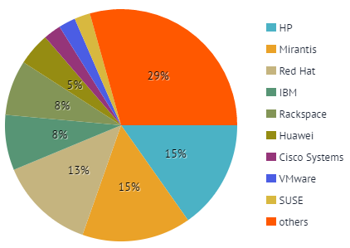
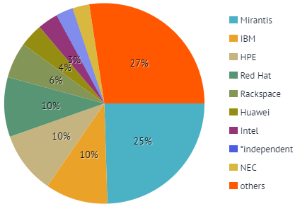
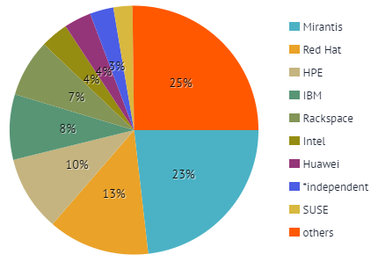
Top companies in OpenStack code contributors
Helion OpenStack 3.0
Contribution by companies for Liberty
# 1 in contributors
# 25866 of reviews
Contribution by companies for Mitaka
# 3 in contributors
# 21390 of reviews
Contribution by companies for Newton
# 3 in contributors
# 3225 of reviews
* Source: stackalytics.com

Slide 5

HPE Helion Portfolio
Cloud Software
Integrated Solutions
Managed Services
HPE Helion CloudSystem Foundation
Core IaaS and PaaS
HPE Helion CloudSystem Enterprise
Advanced hybrid cloud platform
HPE Cloud Service Automation
Cloud management platform
HPE Helion OpenStack®
Open source IaaS
HPE Helion Development Platform
Open source PaaS integrated with Helion OpenStack
HPE Helion Stackato
Open source PaaS for multi-IaaS
HPE Helion Eucalyptus
AWS compatible private cloud software
HPE OneView
Converged infrastructure management
HPE Helion CloudSystem
Fully integrated hybrid cloud solution
HPE Helion OpenStack Carrier Grade
NFV for Service Provider
HPE Helion Managed Virtual Private Cloud
Secure, multi-tenant private cloud
HPE Helion Managed Private Cloud
Secure, dedicated private cloud
HPE Helion Managed Cloud Applications
ERP, CRM, and workplace applications
HPE Helion Managed Cloud Broker
Control and manage cloud services
HPE Helion Veritas Continuity
Cloud-based disaster recovery
Professional Services
HPE Helion Advisory Services
Workshop to set the strategy
HPE Helion Cloud Strategy Services
Build your strategy and roadmap
HPE Helion Application Transformation Services
Workload portability services
HPE Helion Design Services
Cloud services and infrastructure design
HPE Helion Cloud Implementation Services
Rapid implementation
HPE Helion Support Services
Data center care for HPE Helion

Slide 6



Helion OpenStack 주요 제품
오픈스택 기반 엔드 투 엔드 클라우드 통합 솔루션 – 프라이빗 클라우드 구축, 레거시 환경 연동, 클라우드 네이티브 어플리케이션 플랫폼, 멀티 클라우드 서비스 오케스트레이션 & 프로비저닝 자동화
Helion
CloudSystem®
Full 오픈소스 기반 엔트프라이즈급 클라우드 플랫폼 – 퍼블릭 & 프라이빗 클라우드 구축을 위한 기본 플랫폼으로 뛰어난 확장성 및 유연한 아키텍처 제공, 검증된 IT 파트너로써, 오픈스택 기반 클라우드 구축 및 컨설팅 서비스 제공
Helion OpenStack®

Slide 7
HPE Helion OpenStack Value-Add
Based on OpenStack core with enterprise-grade enhancements, support, & protection
HPE Helion OpenStack Global Support, HPE Helion OpenStack Professional Services
HPE Configuration, Lifecycle Management, Security Features
Core OpenStack
Your applications
OpenStack
OpenStack dashboard
Cloud Operating System
COMPUTE
NETWORK
STORAGE
OpenStack shared services
Standard hardware
HPE Configuration, Lifecycle Management, Security Features
HPE’s OpenStack Technology Indemnification Program
Notes:
What Value does HPE add with its’ commercial offering HPE Helion OpenStack? HPE offers an enterprise-grade solution with:
Reduced risk with enhanced security IP at the product level, HPE's OpenStack Technology Indemnification Program, and the peace of mind of HPE Helion OpenStack Worldwide 24/7 support included in each server license
Increased agility and ease of use with HPE Helion OpenStack LifeCycle Management IP & Configuration IP
OpenStack software runs on top of Standard HW, helping customers to create an open source based cloud in a SW defined Data center. With OpenStack technology you can create pools of Compute, NW, Storage, and you create Cloud environment either from a GUI (OpenStack Horizon dashboard) or from applications.
To the OpenStack core of services, HPE adds product level enhancements that provide enterprise level capabilities not always available in the base OpenStack technology components. For example HPE Configuration IP enhances compute and storage functionality HPE adds our unique configuration IP to the basic Nova and Cinder compute configurations found in the OpenStack Trunk, and a streamlining of the integration of ESXi with OpenStack technology. These configurations enhance user capabilities while maintaining portability and no vendor lock-in HPE Helion OpenStack our HPE Configuration, Lifecycle Management, and Security IP to simplify management, secure end points, and ease customer transition and ongoing management of a cloud environment. These enhancement speed time to market for enterprise cloud customers, while maintaining openness and no vendor lock-in by using standard OpenStack APIs for full portability.
At the ecosystem level, HPE Helion OpenStack customers benefit from HPE's OpenStack Technology Indemnification Program and HPE Professional Services for OpenStack.
In addition, HPE understands enterprise customers seek cloud solutions that integrate into the existing environments that they have today.
HPE Helion OpenStack engineers have designed effective integrations with other HPE offerings, allowing customers to more easily transition to an open source-based cloud solution within their existing management environment. Integrations include full support for HPE ProLiant Gen 8 & 9 industry leading servers, HPE Moonshot servers, and HPE Storage enhancements for high availability with HPE 3PAR and HPE StoreVirtual VSA.
HPE also understands that customers have non-HP hardware investments they may wish to leverage. HPE Helion has launched an Independent Hardware Vendor (IHV) program working with 3rd party vendors--such as EMC, Hitachi, Cisco--to certify a wide range of server, storage, and networking infrastructure hardware working with HPE Helion OpenStack. This focus and work to ensure that customers’ existing infrastructure can fit and integrate with an HPE Helion OpenStack deployment is a key pillar of value add beyond what one can find from the OpenStack community. The latest certifications can viewed here on the HPE Helion OpenStack Support Matrix: http://docs.hpcloud.com/helion/openstack/support-matrix/#software-requirements
HPE Lifecycle Management IP: HPE works to make it as simple as possible to install and deploy cloud resources on HPE Helion OpenStack in a deployment model that is suitable for the entry point of the customer based on their cloud journey. For example, HPE Helion OpenStack enables cloud controllers to be deployed on bare-metal servers or in a virtual environment. The open source upstream version of OpenStack doesn’t do this as easily. Beyond the deployment, whether these be initial setup, patching, or update and upgrade maintenance, we understand that clouds grow and are dynamic. HPE Helion OpenStack simplifies the process of adding, extending, or deleting resources quickly and easily. This flexibility is a key premise of any cloud computing platform.
HPE Helion OpenStack also focuses on providing value add with focusing on managing the cloud platform. There are several areas of investment from providing active health monitoring of the end to end cloud infrastructure; to centralized logging all of the alerts and alarms for event correlation to root cause analysis; to telemetry usage metering and internal usage reporting capabilities for showback/chargeback/and billing systems. HPE Helion OpenStack also integrates with HPE Cloud Service Automation (CSA) for expanded lifecycle management capabilities. HPE CSA addresses the challenges business and IT departments face with a comprehensive management platform bridging the management of multiple cloud environments including virtualization investments and traditional IT business applications. HPE Helion OpenStack also provides an integration with Parallels Automation facilitating the needs of telcos and service providers.
Security IP: Identity Management of AD and LDAP, data at rest encryption capabilities, reduction of surface vulnerabilities based on extensive years of experience running OpenStack in the HPE Public Cloud, and centralized Log Management capabilities, including a new integration with HPE ArcSight. HPE Helion OpenStack secures the network during installation by implementing security rules that allow only the ports that need to access the network installation to be opened. Another example is HPE Helion OpenStack enablement of AppArmor to provide an additional layer of automated protection against VM breakouts by proactively protecting the operating system and the applications from external or internal threats. Coming enhancements include an integration with HPE Atalla key encryption capabilities.
Ecosystem Level Enhancements:
HPE's OpenStack Technology Indemnification Program
Subject to the terms and conditions of a separate indemnity agreement, qualified HPE Helion OpenStack customers with a current support agreement are eligible for the HPE's OpenStack Technology Indemnification Program, under which HPE will indemnify, defend, and settle third party copyright, patent, and trade secret infringement claims directed to OpenStack code, alone or in combination with Linux code, in HPE Helion OpenStack. Subject to the terms of the indemnity agreement, HPE is offering this indemnity with no monetary cap, a key differentiator from our competitors that demonstrates HPE's commitment to the OpenStack platform and community. HPE's OpenStack Technology Indemnification Program is available to qualified customers who are direct customers of HPE, direct customers of authorized resellers for HPE Helion OpenStack, and direct customers of qualified service providers using HPE Helion OpenStack to provide services.
HPE's Professional Services for OpenStack technology
HPE has been helping customers deploy cloud and hybrid IT solutions for years and our HPE Helion Professional Services have played a significant role in those successes. HPE Helion OpenStack Professional Services is a dedicated team of professional services consultants available worldwide to accelerate and support OpenStack cloud capabilities and opportunities. These enterprise services are delivered by an experienced team of HPE architects, cloud technologists, and engineers with expertise in design, storage, networking, security, database, scalability, high availability, and other OpenStack-based services.

Slide 8
Helion OpenStack 릴리즈 주기
OpenStack Community Release
Austin Oct 2010 | Bexar Jan 2011 | Cactus Apr 2011 | Diablo Oct 2011 | Essex Apr 2012 | Folsom Oct 2012 | Grizzly Apr 2013 | Havana Oct 2013 | Icehouse Apr2014 | Juno Oct 2014 | Kilo Apr 2015 | Liberty Oct 2015 | Mitaka Apr 2016 | Newton Oct 2016
OpenStack Latest Release
OpenStack Mitaka, 13th release
Helion OpenStack Latest Release
HPE Helion OpenStack & CloudSystem Release
Helion
OpenStack
Helion OpenStack 1.1
(Based on Juno)
Helion OpenStack 2.0
(Based on Kilo)
Helion OpenStack 3.0
(Based on Liberty)
Helion OpenStack 4.0
(Based on Mitaka)
Helion
CloudSystem
Helion CloudSystem 9
(Based on HOS 1.1)
Helion CloudSystem 10
(Based on HOS 3.0)

Slide 9
Helion OpenStack 구축 사례

Slide 10
클라우드 아키텍처 #1 - S사 Public Cloud
Helion OpenStack 플랫폼 위에 서비스 포털을 자체 개발/통합하여, 퍼블릭 클라우드 서비스 인프라 구축
Service Portal
Kilo 기반의 Helion OpenStack (HOS) 2.0을 이용한 IaaS 서비스 구축
CVR (Centralized Virtual Router) 구성에 따라 Traffic 증가 시 부하 집중 해결 필요
Controller에서 Network 서비스 분리 및 3 Node HA 구성
Full SSD 스토리지를 Block Storage로 구성하여 고성능 스토리지 서비스 제공
서비스 사용자 (end user)를 위한 서비스 포탈 별도 구축
OpenStack API 활용
Controller x 3
Swift x 3
Network x 3
Compute x 10
SSD Storage
Elastic Search/ Logstash/Kibana
Monasca
Ops Console
Helion OpenStack (Kilo-based)
오픈소스 기반 클라우드 컴퓨팅 플랫폼 및 하이퍼바이저, 소프트웨어 정의 스토리지 구축을 통해, 퍼블릭 클라우드 서비스에 대한 원가 경쟁력 확보

Slide 11
클라우드 아키텍처 #2 - S사 Private Cloud & Mobile PaaS
Helion OpenStack 기반 인프라스트럭처 서비스(IaaS) 및 개발 플랫폼 서비스(PaaS) 구축, 소프트웨어 정의 스토리지 구현
IaaS Service Portal
PaaS Service Portal
Kilo 기반의 Helion OpenStack (HOS) 2.0을 이용한 IaaS 서비스 구축
Helion Development Platform (HDP) 2.0을 이용한 PaaS 서비스 구축
모니터링 서비스 부하 분산을 위해 모니터링 노드 분리 및 3 Node HA 구성
비용 효율적 스토리지 서비스를 위해 소프트웨어 정의 스토리지 구현
오픈소스 기반 Ceph 스토리지 구성
HDD와 SSD Ceph의 다중 클러스터 구성으로 용도에 따른 사용
IaaS 및 PaaS 서비스 사용자 (end user)를 위한 서비스 포탈을 각각 별도 구축
Controller x 3
Swift x 2
Monitoring x 3
PaaS x 15
HDD Ceph
Compute x 18
SSD Ceph
Elastic Search/ Logstash/Kibana
Monasca
Ops Console
Helion OpenStack (Kilo-based) + Helion Development Platform
클라우드 기반 IT 운영 인프라 구축을 통해, 내부 IT 운영 및 비용 효율성 향상
IaaS & PaaS 통합을 통해 신속한 어플리케이션 개발 및 서비스 운영환경 구축

Slide 12
클라우드 아키텍처 #3 - H사 Private Cloud
Helion CloudSystem 기반으로 그룹 계열사를 위한 산업별 클라우드 서비스 구축
Service Portal
HOS 기반의 통합 솔루션인 Helion CloudSystem을 이용한 IaaS 서비스 구축
IaaS를 위한 Helion OpenStack
PaaS를 위한 Helion Development Platform
Bare Metal 프로비저닝 및 관리 자동화를 위한 CSA/OneView 통합
Helion CloudSystem 참조 아키텍처 준용
멀티 하이퍼바이저 및 물리/가상 서버가 혼재된 하이브리드 환경의 통합 클라우드 관리 플랫폼 제공
제조/서비스 산업과 금융 계열사별 클라우드 플랫폼 구축
1단계 x86 중심 IaaS를 기반으로 PaaS, SaaS 및 Unix 지원 등으로 단계적 확산하고 AWS 연계를 포함한 하이브리드 클라우드 구축 계획
Controller x 3
Industry Cloud
Industry Cloud
Enterprise
KVM Zone
KVM Zone
VMWare Zone
VMWare Zone
Monitoring
PaaS Zone
PaaS Zone
Test & Staging
Test & Staging
Cloud Controller
Bare Metal Zone
Bare Metal Zone
Management
VDI Zone
VDI Zone
Unix Zone
Unix Zone
Helion CloudSystem 9.0
그룹 차원의 IT 운영 비용 절감 극대화
비즈니스 요구에 부합하는 신속하고 유연한 클라우드 기반 IT 서비스 제공

Slide 13
Helion OpenStack® 주요 기능

Slide 14
What's new in v3.0?

Slide 15

What's new in Helion OpenStack 3.0?
Based on Liberty release of OpenStack
Expanded app support
Manageability
Security
멀티 하이퍼바이저 지원 (Red Hat KVM, HPE Helion KVM, ESX)
베어메탈 서버 프로비저닝
VM 라이브 마이그레이션 성능 및 기능 개선
어플리케이션 다운타임 없이, 물리 노드 확장 및 오픈스택 패치 & 업그레이드
인스턴스(VM) 상태 및 성능 모니터링
UI를 통해 물리 컴퓨트 노드 통합 관리
컨트롤러당 최대 200개 컴퓨트 노드 확장 가능 (8천개 이상 VM)
미터링 (showback/chargeback) 및 3rd party 빌링 시스템 연동
컨트롤러 Incremental 백업 및 복구
PCI readiness
데이터 암호화 (구성정보)
클라우드 내 키 보안 강화
KMIP 지원 디바이스 연동
API 트래픽 데이터 암호화
Hardening & Auditing
Role 기반 접근 권한 및 암호 관리 기능 개선
Enterprise grade
CVR 모드에서 네트워킹 이중화
멀티 Swift zone 분리 구성
IPAM 연동 Plugin 지원

Slide 16
HPE Helion OpenStack 3.0 Architecture
OpenStack (Liberty)
Plug-ins
HPE Value-add (Open Source)
Operations Environment
Running Environment
HPE Value-add (HPE Assets)
UI
UI
Operations (OpsConsole)
Dashboard
Storage (StoreVirtual
Dashboard CMC)
OpenStack Dashboard (Horizon)
LBaaS
VPNaaS
FWaaS
DNSaaS
Day Zero
Installer
Logstash
Monasca
Network
Services
LB (LBaaS)
Service
VPN (VPNaaS)
Service
FW (FWaaS)
Service
DNS (DNSaaS)
Service
Logging Search (Kibana)
Dashboard

Octavia
Operational Services
Infrastructure
Services
Deployment (Ansible)
Service
Nova ESX (EON)
Configuration
Identity Service (Keystone)
Local
LDAP/AD
Federation
Key Management
Service (Barbican)

Configuration Processor

Bare Metal
Service (Ironic)
Orchestration Service (Heat)
Deployment Artifacts
Boot Images
Service Playbooks
Deployment Templates
Object (Swift)
Storage Service
Image (Glance)
Library
Service
Compute (Nova)
Service
Network (Neutron)
Service
VXLAN
ML2
VLAN
OVSvApp
DVR
Block Storage (Cinder)
Service
KVM
LHN
Bare Metal (Cobbler)
Provisioning Service
Swift
Swift

RHEL KVM
iSCSI
3PAR
VSA
Ceph
ESX
FC
VMDK
Ceph
IPMI
PXE
UEFI
Metering Service (Ceilometer)
Sub
Systems
HTTPS
Termination
(Stunnel)
Infrastructure
Monitoring Service
(Monasca)
Centralized
Logging (Logstash, ElasticSearch)
Recovery (Freezer)
Management (Backup/Restore Scripts)
Service Fail-over
Management
(HAProxy, Keepalived)
MySQL
Vertica
Rabbit MQ
InfluxDB
Linux for HPE Helion (Debian)
Physical Infrastructure – Servers, Networking, Storage

Slide 17
Features, Benefits, and Value
FEATURE | BENEFITS | VALUE | MARKET SEGMENT
FLEXIBLE TOPOLOGY |  |  | Private Cloud | Managed Cloud | NFV (SP) | NFV (Vendor)
Flexible control plane | Right footprint for the size and usage profile of cloud | Reduce CAPEX by using fewer servers for control plane | ✓ |  | ✓
FLEXIBLE NETWORK TOPOLOGY (UNDERLAY)
NIC bonding | High availability Better performance | Reduce OPEX and increase revenue by saving maintenance time and meeting SLAs | ✓ |  | ✓
Network separation (multi-NIC) | Better performance Increased security | Increase revenue by providing better quality of service Reduce risk / regulatory compliance | ✓ |  | ✓
Provider VLAN, L2 VXLAN gateway | Smooth migration of NFV/ enterprise workloads to cloud | Reduce risk & CAPEX/OPEX | ✓ |  | ✓
EASE MANAGEMENT
User Experience on top of HLM | Build UI driven workflows using HLM | Improve end user experience | ✓ | ✓ | ✓ | ✓
Scale out the cloud without downtime | Highly available & scalable cloud | Reduce OPEX and increase revenue by saving maintenance time and meeting SLAs | ✓ | ✓ | ✓

Slide 18
Features, Benefits, and Value
FEATURE | BENEFITS | VALUE | MARKET SEGMENT
FLEXIBLE BARE METAL PROVISIONING |  |  | Private Cloud | Managed Cloud | NFV (SP) | NFV (Vendor)
Operator can choose to use their existing OS installation tool | Enterprise IT & cloud admin can use their favorite or existing tool Existing compliance procedures intact | Reduce OPEX in adopting new tool | ✓
CUSTOMIZABLE OPENSTACK SERVICES (HPE SUPPORT VIA PROFESSIONAL SERVICES)
Customize compute scheduler filters | Better utilization of compute resources | Reduce CAPEX | ✓ | ✓
Upstream supported cinder/ neutron plugins | Reuse existing storage hardware Use their favorite networking gear | Reduce CAPEX | ✓
UPGRADE
Live updates (bug fixes, security patches) & seamless upgrades (major version) | Highly available & secure cloud | Reduce OPEX and increase revenue by saving maintenance time and meeting SLAs | ✓ | ✓ | ✓

Slide 19
Installation Architecture

Slide 20
Cloud Model
Configurable
Defined by HOS
Service
Service Endpoints are attached to Networks in a Network Group
Networks in a group may be tagged as being significant for a service
Control Planes run
one or more Services
Networks can be used by servers in one or more Server Groups
Cloud
A Cloud
consists of one
or more Control Planes
Control Plane
Control Planes use servers and networks from one or more server groups
Server
Group
Network
A Network is part of a
Network Group
Network
Group
Server Groups can form a hierarchy
Network Groups may
define routes to other
Network Groups
Servers can be in a Server Group
Networks within a Network
Group route to each other
Server
An interface model maps
network groups to specific sets of (bonded) ports
Control Planes use servers with particular roles to run different sets of services
Servers can be linked to a NIC Mapping that enumerates network ports
Servers have a Role which defines how they will be used in the cloud
NIC
Mapping
The NIC Mapping provides the mapping of physical interfaces
Disk
Model
The Role of a server determines which Disk Model is used to configure its local storage
Server Role
The Role of a server determines which Interface Model is used to configure its network interfaces
Interface
Model
Notes:
The cloud model describes the physical underlay for your cloud (servers, network and storage) and how OpenStack and other services map onto this infrastructure. It is the core interface into HOS lifecycle management.
0. There is one cloud (each instance of a model describes one cloud). A cloud can have one or more Control Planes.
A Control Plane runs one or more services (e.g. nova-api). Services expose end-points.
Control Planes use servers that have a Role to run different sets of services. (e.g. a role might be “compute” or “control plane”).
Servers can be in a server group. Server Groups correspond to physical failure domains (e.g. Datacenter, rack, enclosure). Availability zones in Cinder, Nova etc are specified by Server Groups. L3 networks are assigned to a Server Group. Server Groups form a hierarchy.
Servers can be linked to a NIC mapping which enumerates bus addresses physical interfaces so that we know we are talking to the right interface.
Servers have a Role which is linked to a Disk Model. This controls how local storage is presented.
A Network is part of a Network Group. Service endpoints are attached to Networks in a Network Group.
Network Groups may define routes to other Network Groups
Servers have a Role which is linked to an Interface Model. This maps Network Groups to specific sets of (optionally bonded) ports. The NIC mapping makes sure we know that we are talking to the right NIC.
A Network Group has 1 or more Networks associated with it. A Network is associated to one or more Server Groups. Networks within a group must route to each other.
Control Planes use servers and Networks from one or more Server Groups.

Slide 21
Installation Workflow
Automated
User Input
Manual
Optional
1. Setup deploy network
2. Bootstrap
3. Choose topology
4. Identify servers
5. Linux install
6. Customize configuration
Setup network that will be used to deploy the cloud
Normally first NIC on all nodes
Boot initial node
Normally first server in control plane
Initialise lifecycle management components
Base cloud on one of shipped examples
Small scale
Medium scale
Demo
List servers that are to be part of cloud
If skipping Linux install then this moves to step 7
Baremetal install
Cobbler
HP Host Linux for OpenStack
Network separation
Local storage
OpenStack config
Linux config
ERRORS? ITERATE!
7. Assign server roles
8. Run config processor
9. Prep / validate underlay
10. Linux configuration
11. OpenStack install
12. Verify cloud
12. Verify cloud
Assign servers to roles
Perform NIC mapping
Validate configuration
Generate per-node configuration values from overall cloud definition
Firmware
Remote (SAN) storage prep
BIOS config
Routing
VLAN setup
…etc/
Base packages
Network interfaces
Incl. NIC bonding
Config
Incl. iptables / sysctl
Start services
Status check (services running)
OpenStack code
Config files
Pre-req packages
Start services
Status check (services running and packages installed)
Tempest
DefCore / RefStack
Notes:
This slide introduces the steps that a cloud admin will perform for the first-time install use-case. The system is very flexible – this is just one possible workflow of many.
Setup deploy network – this is the network that will be used to deploy HOS. Network booting the servers to install Linux and then for Ansible access (via SSH).
Bootstrap initial server – HOS is shipped as an ISO. Boot this ISO and install HOS lifecycle management components on the first server of your control plane. Can use USB, CD or iLO Virtual Media etc.
Choose topology – HOS ships with a number of example topologies. You will choose one of these on which to base your cloud. (More on the shipped topologies later.) You can customise this example to better suit your needs in the upcoming steps.
Identify servers – You need to tell us about the servers that will make up your cloud.
Linux install – here we PXE boot your servers and install a base Linux operating system (HP Linux for Helion, a Debian derivative). At the completion of this step you will be able to SSH into all your servers. This step is optional: if you have your own server imaging solution then you can use that to install the supplied image and continue from step 6 (you will still need to tell HOS about the servers and ensure that they are accessible via SSH from the lifecycle management server.)
Customize configuration – change the example config that you chose in step 3 to better meet your needs. This config describes both the underlay (servers, networks and storage), how OpenStack services map to the underlay and how the OpenStack services are configured.
Assign server roles – tell HOS which server should do what. You will have a list of roles that depends on the example that you chose in step 3. HOS can assign roles for you if you don’t have specialized hardware.
Run config processor – this is the heart of HOS lifecycle management. It converts the configuration that you described in steps 3, 4, 6 and 7 from a nice easy-to-use, normalised data model into the specific values that Ansible will deploy on each server. It deals with IP address allocation, resolution and provision of dependencies and much more. The config processor will feedback warning and errors if your model contains mistakes or inconsistencies. You might need to go back to step 6 in order to correct these.
Prep / validate underlay – the config processor outputs a set of information about what the physical underlay needs to look like. You will need to ensure that your physical works looks as expected. The most important things to check are that the right VLANs are exposed to the right ports and that the necessary routing is in place.
Linux configuration – in this step we take the base Linux install performed in step 5 and configure it for your cloud needs. This is a separate step so that, in future, we could support different host operating systems. There is a status check at the end of this step.
OpenStack install – deploy the OpenStack services and start them up.
Verify cloud – at the end of the deployment you have the option to verify your cloud using the Tempest tests. These tests will exercise your new cloud as an end user would. The will report that your cloud conforms to the OpenStack DefCore standard for interoperability between different OpenStack clouds.

Slide 22
Architecture
Filesystem Directory Structure
~/helion/
├─examples/
│ ├─one-region-poc-with-vsa/
│ └ …
├─my_cloud/
│ ├─definition/
│ │ ├─data/
│ │ │ ├─servers.yml
│ │ │ └ …
│ │ └─config/
│ │ ├─swift/
│ │ │ └─rings.yml
│ ├─config
│ │ ├─logging
│ │ ├─neutron
│ │ ├─nova
│ │ └ …
└─hos/
├─ansible/
└─services/
Cloud Model
HTTP Server
ceilometer-api
HP Linux Repo
Binary packages in debian repo format
swift-proxy
ansible
installed at system level (/opt/stack/)
installed at user level (/home/username/)
monasca-agent
Python Software
Standalone virtual environments
Config Processor
Ansible Playbooks
ansible/
├─roles/
│ ├─nova-compute/
│ │ ├─defaults/
│ │ ├─handlers/
│ │ ├─meta/
│ │ ├─tasks/
│ │ │ ├─configure.yml
│ │ │ ├─install.yml
│ │ │ ├─start.yml
│ │ │ ├─status.yml
│ │ │ ├─stop.yml
│ │ └─templates/
│ │ ├─compute.conf.j2
│ │ └─compute-logging.conf.j2
│ └ …
├─hlm-deploy.yml
├─nova-deploy.yml
└ …
Misc
Other binaries and web content
nova-api
cinder-api
neutron-server
managed by
glance-api
Git Repo
GUI
Cobbler
2.0.0
hos
2.1.0
site
staging-cp-persistent
staging-ansible
cp-persistent
ansible
Notes:
This slide introduces the architecture of the lifecycle services in HOS 2.0. On the left are services installed at the system level, on the right are config and ansible that are defined a the cloud admin user level.
On the deployer system (left-hand side):
HTTP Server that serves
Debian packages for system software install and update
Python virtual environments for OpenStack and related
Misc content and software (such as JARs for Monasca)
Web-based GUI installer app
Python software repo also contains Config Processor
A simple python app that takes the Cloud Model and derives the per-server information
Cobbler for bare metal installs
For the deployer user (right-hand side):
A filesystem directory structure that is managed by…
…a Git Repo (more info in a later slide)…
…and contains…
1. The Cloud Model (more info in a later slide)
2. Ansible playbooks for installing the cloud
3. OpenStack (and other) config file templates
4. Some example models to get you started

Slide 23
Where Does It Happen?
1. Setup deploy network
2. Bootstrap
4. Identify servers
5. Linux install
7. Assign server roles
8. Run config processor
9. Prep / validate underlay
10. Linux configuration
11. OpenStack install
3. Choose topology
6. Customize configuration
12. Verify cloud
Mapping install workflow to architecture
Filesystem Directory Structure
~/helion/
├─examples/
│ ├─one-region-poc-with-vsa/
│ └ …
├─my_cloud/
│ ├─definition/
│ │ ├─data/
│ │ │ ├─servers.yml
│ │ │ └ …
│ │ └─config/
│ │ ├─swift/
│ │ │ └─rings.yml
│ ├─config
│ │ ├─logging
│ │ ├─neutron
│ │ ├─nova
│ │ └ …
└─hos/
├─ansible/
└─services/
Cloud Model
HTTP Server
ceilometer-api
3
4
HP Linux Repo
Binary packages in debian repo format
swift-proxy
11
10
ansible
installed at system level (/opt/stack/)
7
installed at user level (/home/username/)
monasca-agent
Python Software
Standalone virtual environments
Config Processor
6
8
11
Ansible Playbooks
ansible/
├─roles/
│ ├─nova-compute/
│ │ ├─defaults/
│ │ ├─handlers/
│ │ ├─meta/
│ │ ├─tasks/
│ │ │ ├─configure.yml
│ │ │ ├─install.yml
│ │ │ ├─start.yml
│ │ │ ├─status.yml
│ │ │ ├─stop.yml
│ │ └─templates/
│ │ ├─compute.conf.j2
│ │ └─compute-logging.conf.j2
│ └ …
├─hlm-deploy.yml
├─nova-deploy.yml
└ …
Misc
Other binaries and web content
nova-api
5
11
cinder-api
8
neutron-server
glance-api
managed by
Git Repo
10
GUI
Cobbler
2.0.0
hos
2.1.0
11
5
8
site
staging-cp-persistent
12
staging-ansible
cp-persistent
ansible
Notes:
This slide maps the first-time install use-case workflow to the architecture so that you can understand which component is responsible for which step.
All steps can be done in the GUI unless otherwise stated.
Setup deploy network – done outside HOS. CLI only.
Bootstrap – Installs the system level and most of the user-level software. Starts the GUI. CLI only.
Choose topology – copy an example to my_cloud.
Identify servers – enter your server information. Will be MAC + iLO creds if we are doing Linux install or IP addresses if customer is doing Linux install.
Linux install – Kicked off by an Ansible playbook, done by Cobbler.
Customize configuration – done in the config/ sub-directory. CLI only but optional.
Assign server roles – done in the cloud model.
Run configuration processor - Kicked off by an Ansible playbook. Need to commit your changes to git repo first.
Prep / validate underlay – manual. Config processor provides a report to help you though.
Linux configuration – Ansible playbooks install software from HP Linux for Helion OpenStack repo and configure and start it.
OpenStack software install – Ansible playbooks install software from Python Software repo, HP Linux for Helion OpenStack repo and Misc repo and configure and start it.
Verify cloud – Ansible playbooks.

Slide 24
Update Workflow
Automated
User Input
Manual
Optional
1. Download new release
2. Update lifecycle manager
3. Merge customizations
4. Run config processor
5. Update cloud
6. Verify cloud
Download from HDN
Side-load possible if no external connectivity is available
Cobbler
Config processor
Git-controlled assets
Ansible playbooks
OpenStack configs
Customer topology
Python repo
Linux package repo
Misc repo
For simple clouds this step will be done automatically
Possibly some manual intervention required based on:
Amount of change in this update
Amount of customisation applied to the cloud
Validate new updated configuration
Generate per-node configuration values from overall cloud definition
Apply the new code and configuration to the cloud
Tempest
DefCore / RefStack
ERRORS? ITERATE!
Notes:
This slide introduces the steps that a cloud admin will perform for the update use-case.
Download new release – you are responsible for getting the new release onto the server where your lifecycle management components run.
Update lifecycle manager – in this step you run an Ansible playbook that will update the lifecycle manager itself.
Merge customizations – here you will merge any customizations that you made to your cloud configuration with the update that HP shipped (see later slide for considerations here). IF you made simple or recommended customisations then HOS will do this for you automatically. IF you have made complex or extensive customisations you might have some work to do here. The result of this step is an updated cloud configuration model.
Run config processor – this generates the new config values from the updated model that you just created.
Update cloud – this step uses Ansible to deploy the new code and configuration to all servers that make up your cloud. It is a repeatable step so if, for example, one server was offline during an update you can re-run the update at a later date.
Verify cloud – you can optionally verify the cloud again after update.

Slide 25
Where Does it Happen?
1. Download new release
2. Update lifecycle manager
3. Merge customizations
4. Run config processor
5. Update cluster
6. Verify cloud
Mapping update workflow to architecture
Filesystem Directory Structure
~/helion/
├─examples/
│ ├─one-region-poc-with-vsa/
│ └ …
├─my_cloud/
│ ├─definition/
│ │ ├─data/
│ │ │ ├─servers.yml
│ │ │ └ …
│ │ └─config/
│ │ ├─swift/
│ │ │ └─rings.yml
│ ├─config
│ │ ├─logging
│ │ ├─neutron
│ │ ├─nova
│ │ └ …
└─hos/
├─ansible/
└─services/
Cloud Model
HTTP Server
ceilometer-api
HP Linux Repo
Binary packages in debian repo format
swift-proxy
ansible
installed at system level (/opt/stack/)
5
installed at user level (/home/username/)
monasca-agent
Python Software
Standalone virtual environments
Config Processor
4
5
Ansible Playbooks
ansible/
├─roles/
│ ├─nova-compute/
│ │ ├─defaults/
│ │ ├─handlers/
│ │ ├─meta/
│ │ ├─tasks/
│ │ │ ├─configure.yml
│ │ │ ├─install.yml
│ │ │ ├─start.yml
│ │ │ ├─status.yml
│ │ │ ├─stop.yml
│ │ └─templates/
│ │ ├─compute.conf.j2
│ │ └─compute-logging.conf.j2
│ └ …
├─hlm-deploy.yml
├─nova-deploy.yml
└ …
Misc
Other binaries and web content
nova-api
2
5
cinder-api
neutron-server
glance-api
managed by
5
Git Repo
GUI
Cobbler
2.0.0
hos
2.1.0
6
site
3
staging-cp-persistent
staging-ansible
cp-persistent
ansible
Notes:
Updating the system-level stuff on the left is easy. Updating the stuff on the right where there is customer data and customisations is harder.
Git repo to the rescue.
Download new release – you are responsible for getting the new release and copying it to the HOS lifecycle management server.
Update lifecycle manager – run an Ansible playbook to complete this step.
Merge customisations – this is handled by the git change control system. See next slide for more details.
Run config processor – happens in a python virtual environment as shipped by HOS.
Update cloud – runs a series to Ansible playbooks that pull software and configuration from the lifecycle management services.
Verify cloud – tempest runs in a virtual environment just like any other OpenStack software.

Slide 26
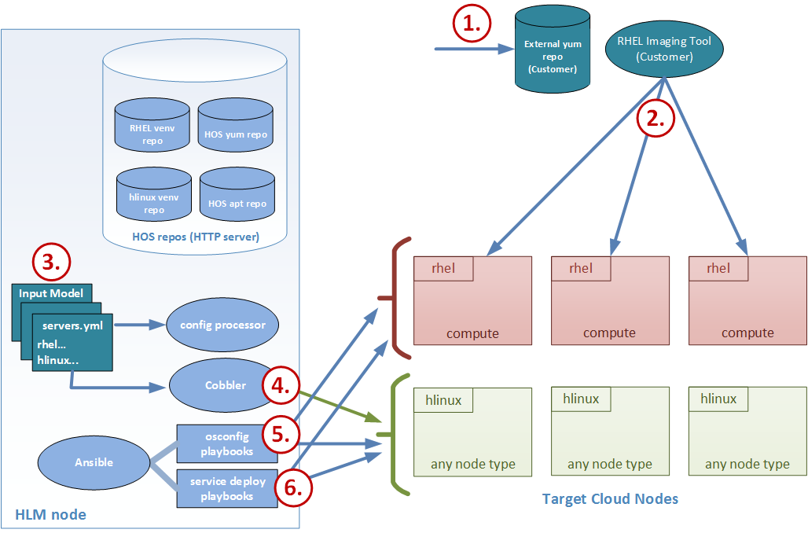
RHEL compute nodes – deployment workflow
Customer deploys and manages RHEL nodes
Notes:
Customer sets up external yum repo, containing a HOS-supported RHEL distro.
Customer provisions a set of compute nodes with a base RHEL OS using their own in-house mechanism and external yum repo.
HOS will provide a sample kickstart file that the customer can adapt for use in their environment.
Customer prepares input model files describing the desired cloud deployment and the runs these through the configuration processor.
This input includes a servers.yml listing both rhel and hlinux target nodes (need a means to differentiate distros between sets of nodes).
Cobbler is used provision target cloud nodes (except the RHEL nodes) with a base hlinux OS, using the HLM Ansible bm-reimage playbook.
The osconfig playbooks are run against all target nodes:
The RHEL nodes yum conf is extended to also point to a HOS yum repo on the deployer that contains a small number of extra packages that do not ship with RHEL.
All osconfig playbooks (including networking setup) adapted to work against RHEL or hlinux.
Package installs on RHEL nodes during the osconfig run are pulled primarily from the external yum repo set up by the customer, with extras coming from the HOS repo.
The service playbooks (hlm-deploy) are run against all target nodes:
All service playbooks (including networking setup) adapted to work against RHEL or hlinux.
Package installs on RHEL nodes during the hlm-deploy run are pulled primarily from the external yum repo, with extras coming from the HOS repo.

Slide 27
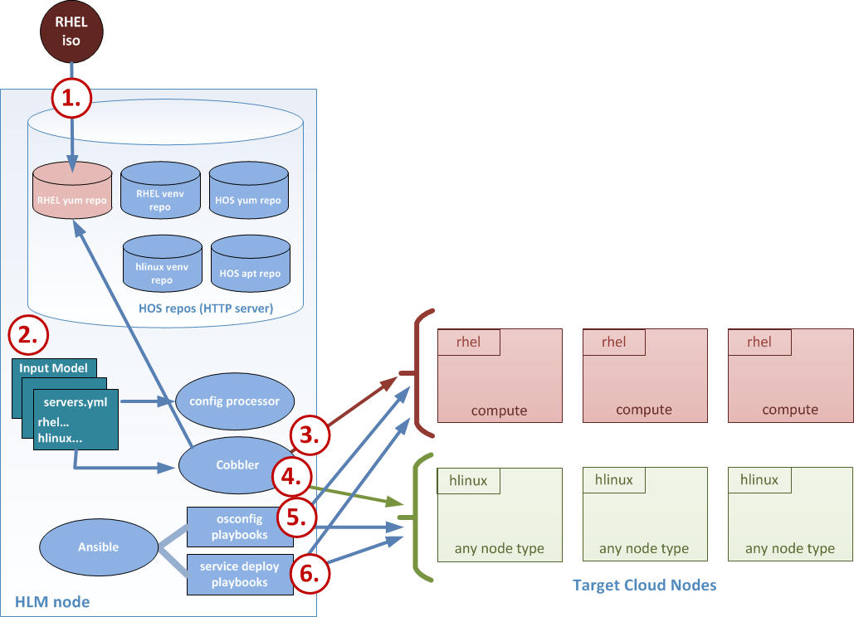
RHEL compute nodes – deployment workflow
HLM deploys and manages RHEL nodes

Slide 28
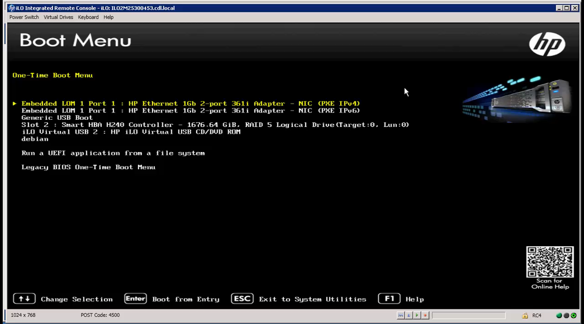
Installation by UI
Simple installation with flexible deployment modeling
Lifecycle Management
Day Zero Installer
(wizard)
Ansible
(deployment)
Cobbler
(bare metal provisioning)

Slide 29
Deployment Models

Slide 30
Entry Scale Cloud with KVM
Qualified Example
Use Cases: PoC, Production
Node Count: 4 – 106
Control Plane: 3 nodes
Object Store: Swift in control plane
Block Storage: 0 or 3 VSA nodes (or optional external 3PAR)
Compute: 0 – 100 KVM nodes
Physical Network: 1 pair bonded NICS
Control Plane (3)
services
bond0
eth0
eth1
Management | Internal management traffic + iSCSI | VLAN: 100, untagged CIDR: 10.2.1.0/24
External API | Clients connect to cloud API endpoints | VLAN: 101, tagged CIDR: 10.2.2.0/24
External | External access for VMs (floating IPs) | VLAN: 102, tagged CIDR: 10.2.3.0/24
Guest | Guest private traffic (VxLAN) | VLAN: 103, tagged CIDR: 10.2.4.0/24
eth0
eth1
eth0
eth1
Compute (1..100)
VSA (0..3)
bond0
bond0
ovs
services
services
Guest VM
Notes:
Entry Scale Cloud. Tested up to 100 compute nodes. Network separated into 4 VLANs that are sent over 2 bonded NICs. A minimal Swift installation is available running on the control plane. This configuration is tested to support either: no block storage, 3 VSA nodes or an external 3PAR.

Slide 31
Medium Scale Cloud with KVM
Qualified Example
Rack 1
Rack 2
Rack 3
Core Cluster
Core Cluster
Core Cluster
Use Cases: Production
Node Count: 10 – ???!
Control Plane: 15 nodes in 5 clusters
Object Store: 3 – ???!
Block Storage: 0 or 3 if VSA nodes
(optional any external Kilo Plug-ins)
Compute: 0 – ???! KVM nodes
Physical Network: 1 pair bonded NICS
L3 segmentation
Metering & Monitoring
Metering & Monitoring
Metering & Monitoring
Database & MQ
Database & MQ
Database & MQ
Swift Proxy/Account
Swift Proxy/Account
Swift Proxy/Account
Neutron Network
Neutron Network
Neutron Network
Internal API | Cloud internal API traffic
External API | Clients connect to cloud API
iSCSI | Block storage traffic
Swift | Object traffic
External | External access for VMs
Management | Internal management traffic
Guest | Guest private traffic (VxLAN)
Compute
Compute
Compute
Compute
Compute
Compute
Compute
Compute
Compute
Object
Object
Object
Object
Object
Object
Object
Object
Object
VSA
VSA
VSA
Customer routing
x
Customer routing
x
Customer routing
x
Notes:
Medium Scale Cloud (technical preview). Control plane runs on 15 servers instead of 3 for entry scale giving your cloud much greater scaling capabilities. Network traffic is separated into 7 zones.
This configuration is labelled technical preview as there has not been as extensive testing of the limits and capabilities of this configuration. No scale figures are supplied.

Slide 32
Entry Scale Cloud with mixed hypervisors
Qualified Example
External routing
EXTERNAL_VM
EXTERNAL_API
DCM (Vcenter) Network
Internal routing
Tenant VLANs
Provider VLANs
MGMT
os-install/ansible
eth0
bond0
eth0
bond0
eth0
bond0
eth0
eth1
eth0
eth1
eth0
eth1
eth2
eth0
Cloud controller
Cloud controller
MML
Cloud controller
DBMQ
Deployer
KVM compute
ESX compute
ovsvapp
Cloud controller
Cloud controller
MML
Cloud controller
DBMQ
Use Cases: PoC, Production
Node Count: 9 – 208
Control Plane: 2 core + 3 MML + 3 DBMQ
Object Store: Swift in control plane
Block Storage: Cinder in control plane
Compute: 1 – 200 ESX/KVM nodes
Cloud controller
MML
Cloud controller
DBMQ

Slide 33
Entry Scale Bare Metal (Ironic) Cloud
Qualified Example
External routing
EXTERNAL-API
GUEST
Internal routing
MGMT
Ironic nodes are not included in the model
bond0
bond0
ethN
Cloud Controller
Compute Nodes
Ironic
Nodes
Routing notes:
EXTERNAL-API may need to be reachable from EXTERNAL-VM if Ironic nodes need access to Cloud API
Cloud IPMI/iLO must be reachable from the lifecycle-manager for Operating System install
Ironic IPMI/iLO must be reachable from the Cloud
iLO
Cloud Controller
…
Cloud Controller
Cloud IPMI/iLO network for Controllers and Compute Servers not shown
Guest network must be tagged at switch port for Ironic nodes
Guest network used for PXE and access to provisioned Ironic nodes

Slide 34
High Availability

Slide 35
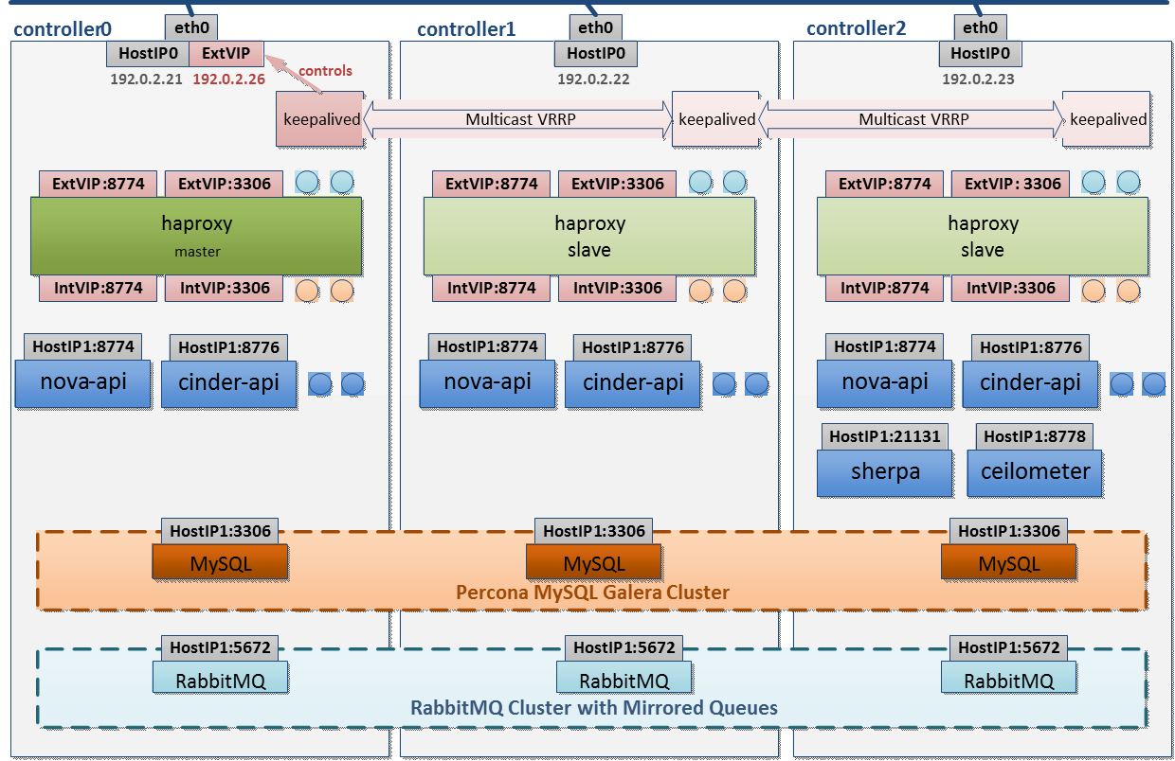
Control Plane High Availability (1/3)
Notes:
Helion Control Plane HA is based on 3-node cluster.
Openstack API services are active/active and is implemented using haproxy and keepalived.
HA-PROXY maps an external IP (Virtual IP) to internal IP. All the APIs are accessed via the external IP. There is one external IP for the control plane and it maps to 3 internal-IP which is specific to each controller.
Keepalived sends keepalives between the nodes to monitor failure and keeps the external IP active on one controller (active controller).
The following set of slides explain an example call-flow of how nova-api is used in a HA setup

Slide 36
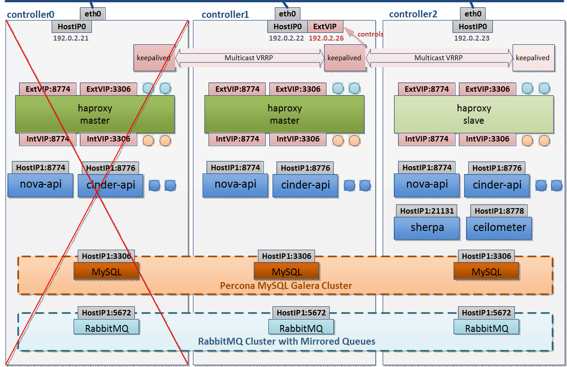
Control Plane High Availability (2/3)
Notes:
This slide explains the HA scenario:
In case if controller0 fails or network-interface on controller0 fails, then keepalived will monitor it and make the external-VIP active on controller1.
Controller1 is active-controller and it will be processing all the OpenStack API requests.
This slide concludes how haproxy and keepalived is used to provide highavailability for Openstack API services.

Slide 37
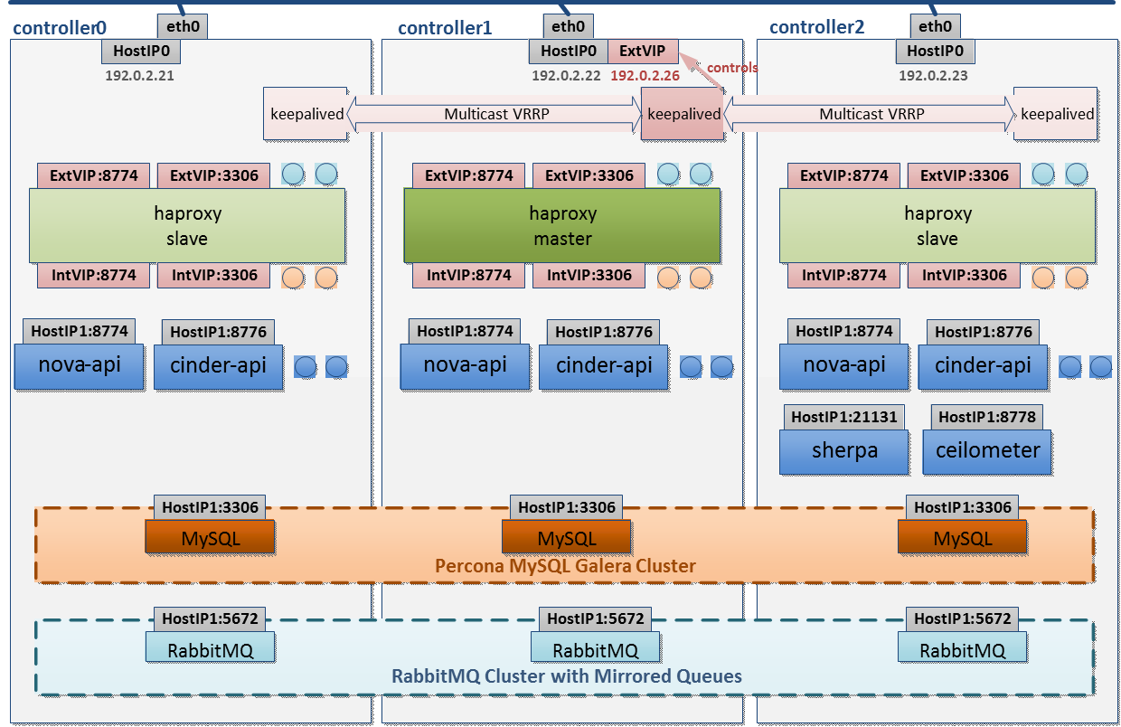
Control Plane High Availability (3/3)
Notes:
Here are concentrate on 2 other important elements on Helion OpenStack control plane
MySQL DB – Most OpenStack services store their state information in MySQL DB. Helion OpenStack uses Percona MySQL Galrea clustering to achieve active/active redundancy for the database. Basically, the database writes can happen in any node and MySQL layer takes care of replicating the state to all the nodes.
Rabbit MQ – The message Q used for internal communication between the OpenStack services is based on Rabbit MQ. Rabbit MQ is clustered using Mirrored Queues and the queue state is maintained active/active across the nodes.

Slide 38
Backup and Recovery of the Control Plane

Slide 39
Backup and Recovery in HOS 3.0 - Highlights
Service
Open source project Freezer
https://github.com/stackforge/freezer
Architecture
OpenStack aware scalable architecture
Extensible to backup/recovery of Tenant VMs/Data
What’s backed-up?
Backup/Recovery of Control Plane services and Deployer node
Key features
Point-in-Time backup of file system and MySQL database
Time-synchronized backup across multiple nodes
Backup Targets
Swift, External SSH server, Local Storage
Efficiency Features
Scheduling of backups
Backups can be incremental, compressed and encrypted
Notes:
Freezer is project name for BURA (BackUp, Recovery, Archive) functionality. It’s an API based service. Freezer is planned to be upstream Openstack Service in 4Q 2015/1Q 2016.
OpenStack awareness – a) integrates with Keystone, Swift b) automated jobs are aware of location of files of OpenStack services and backup/restore them appropriately c) in future, plan is for integration with Nova snapshots, Cinder volume backup
Scalability – The architecture (explained in the next page) allows better scalability. One example: the freezer_agent talks to the backup target directly (without going through centralized backup server)
Control Plane – The main data we backup in HOS 2.0 for Control plane are a) My SQL database b) Swift Rings
Deployer Node – home directory of the deployer node is backed up
2 or more backup jobs running across multiple nodes can be time-synchronized (to a reasonable extent)
5. Incremental backups – Backs up only the changes instead of the entire dataset

Slide 40
Backup/Recovery Architecture
3. Execute Backup/Restore
Swift (or)
SSH Server (or)
Local Storage
Freezer Scheduler
4. Backup or Restore to/from target
Freezer Agent
1. Authenticate and add jobs
5. Save job status
2. Authenticate and fetch jobs
Component | Description | Runs on
API | API service to add/fetch freezer jobs to ElasticSearch DB | Controllers which has the ElasticSearch DB service
Scheduler | Daemon that stores and retrieves backup/restore jobs and executes them | All nodes that require backup/restore (Controller , Deployer)
Agent | The agent that backup/restore to/from targets. Can be invoked from scheduler or via CLI | All nodes that require backup/restore (Controller, Deployer)
ha-proxy
Keystone
Freezer API
Elastic Search DB
(Freezer Jobs)
Notes:
This slide explains the high-level architecture of Freezer. (Light Blue- Freezer component, Dark Blue – Components that Freezer depends on)
For details visit - https://github.com/stackforge/freezer/blob/master/README.rst
The main components are explained in the table above.
Example call-flow for freezer backup/restore
1. User/Operator uses Freezer_Scheduler CLI interface to add backup/restore jobs. The jobs describe details of backup/restore (example, path of the file, type of backup, scheduled/one-time backup etc). The user/operator is authenticated by keystone and the jobs are added to the Elastic Search DB on controller nodes via the Freezer-API ( Automatic jobs to backup control-plane data are added by freezer HLM/Ansible scripts)
2. Freezer-scheduler periodically checks via the freezer_api to fetch the list of jobs and schedules them accordingly (i.e.. one-time backup or schedule-based-backup).
3. Invoke the freezer_agent to execute the backup/restore job
4. Freezer Agent does the actual execution. It directly communicates with the target (Swift/SSH-Server/LocalStorage). No need to go through a backup server
5. On Successful job completion, the job status is stored back to the Elastic Search DB.

Slide 41
Interfaces

Slide 42
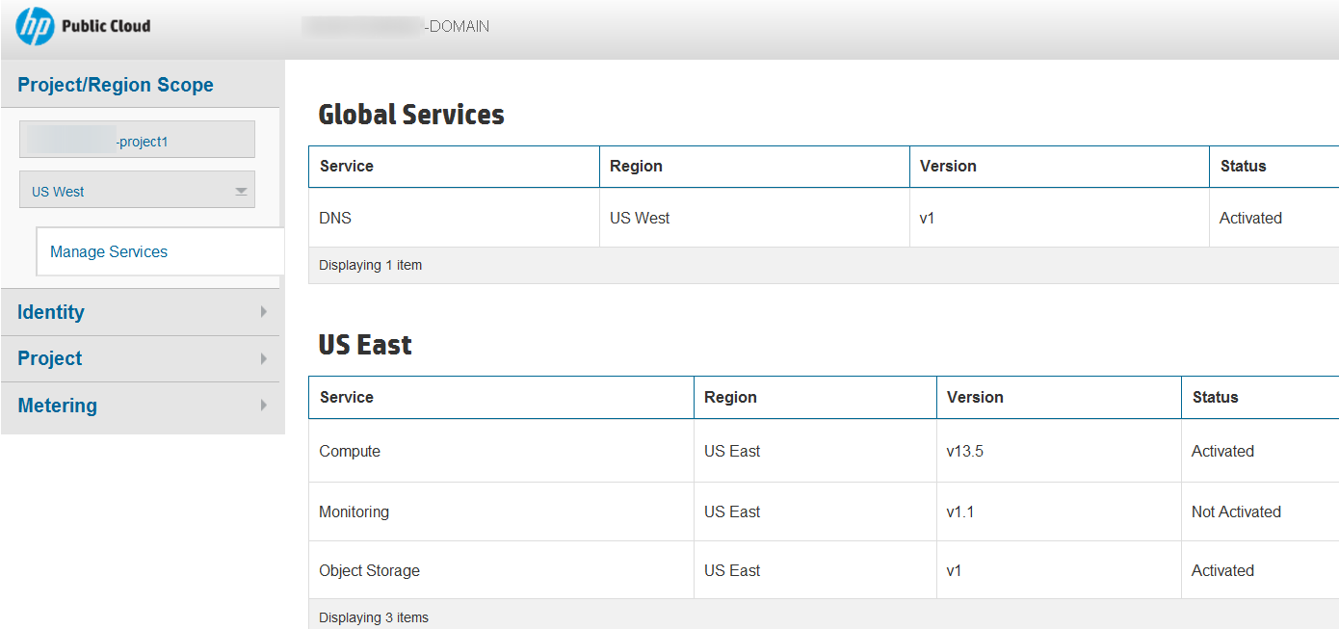
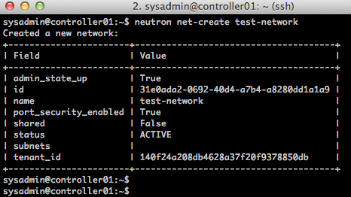





Interfaces for HP Helion OpenStack
GUI
CLI
RESTful
Open interfaces | OpenStack | Target audience
GUI (Graphical User Interface) | Horizon (Dashboard) | Cloud Administrator Administrator Tenants
CLI (Command Line Interface) | CLI (Python clients) | Cloud Administrator
API (Application programming interface) | RESTful API | DevOps Developers
Helion OpenStack
ESX, KVM
Physical Infrastructure

Slide 43
Horizon
What’s New?
Curvature Network Topology
Ironic service support
Ironic service provides support for provisioning of bare metal servers
Horizon provides web interface for configuring and managing bare metal server deployments via the Ironic service
Keystone Domain administration support
Domains provide the top level of the Keystone service authentication and authorization organization model
Domain administration management support now available via Horizon web interface
Default Horizon authentication page provides support for Domain selection
OpenStack CLI RC file for Keystone v3 API
RC files are used by OpenStack CLI clients for setting environment variables including service authentication and access
Helion OpenStack v3 provides downloadable access to both Keystone v2 and v3 compatible RC files based on authentication credentials
New Hewlett Packard Enterprises (HPE) branding

Slide 44
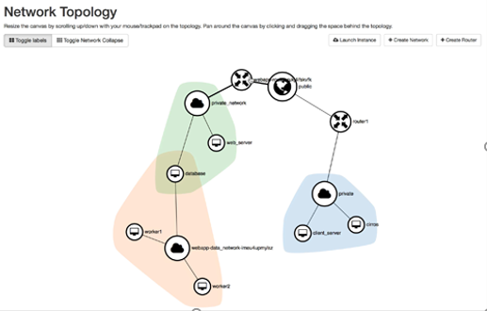
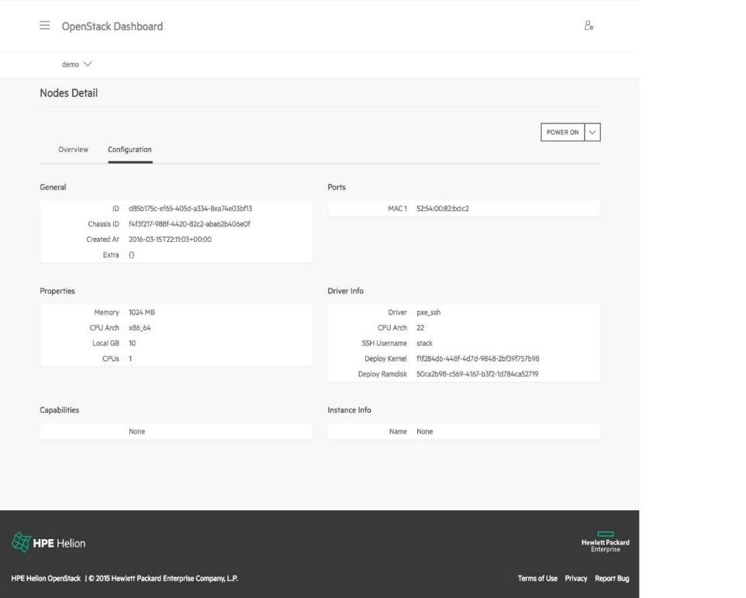
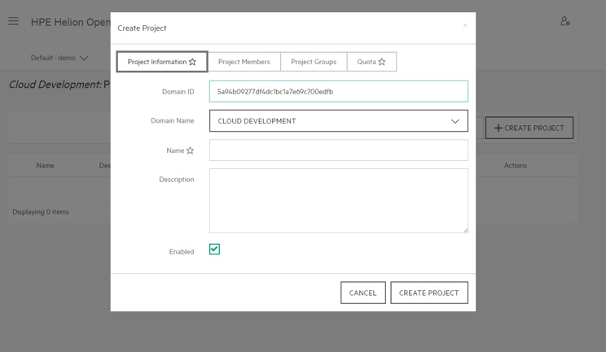
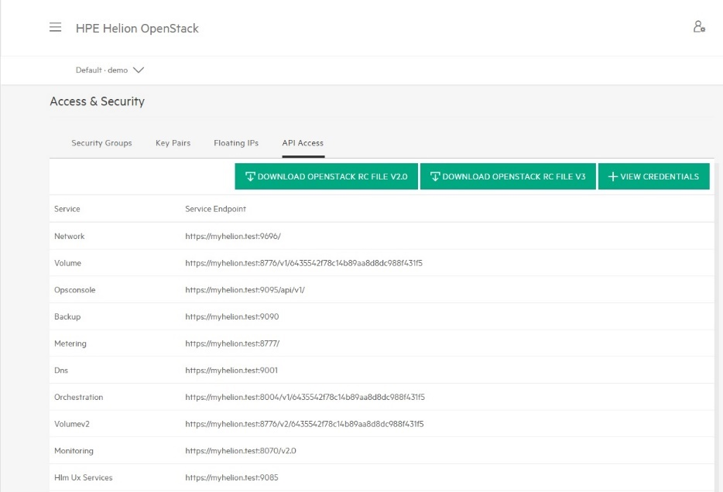
Horizon
Ironic Service UI
Curvature
Network Topology
Domain Management UI
OpenStack CLI RC File Support

Slide 45
Compute Service

Slide 46
Compute – Nova
Hypervisors
HPE Linux KVM
RHEL KVM
ESX
Bare metal
Notes:
The OpenStack components (nova, neutron, cinder, etc) create JSON logs in the /var/log/<OpenStack component>. The Centralized Logging Service extracts the component level logs and funnels them into a pipeline and centralized storage.
The process starts with the Beaver daemon on each host watches data being added to the log files specified in the /etc/beaver/conf file
When a new message is logged a message to the RabbitMQ logstash-queue is generated. Logstash receives any message sent to the logstash-queue. Configuration is in the /etc/logstash directory. Logstash runs filters against the messages received from RabbitMQ. A basic filter view is provided as the default but how to create filters is a well-documented process in the elastic community. Logstash outputs all messages that have been received based on any output configuration. The Default is to use the elasticsearch_http interface to store the message in Elasticsearch database. Messages are stored in the Elasticsearch data store in the logstash-<YYYY-MM-DD>. Data can be queried directly through the Elasticsearch REST interface. Elastic search should be configured to only allow queries from the local machine. Kibana Dashboards query the Elasticseach data store and build customizable queries to help analyze and comprehend the log data. Kibana contacts the Elasticsearch data store to query the data in the logstore indices.

Slide 47
Compute – Nova
Features
Availability Zones / Host Aggregates
Server Groups (Affinity, Anti-Affinity)
Tenant and User Quotas
Live Migration of VM
Cold Migration and Resize of VM
Evacuate VM
Nova Console

Slide 48
Block Storage

Slide 49
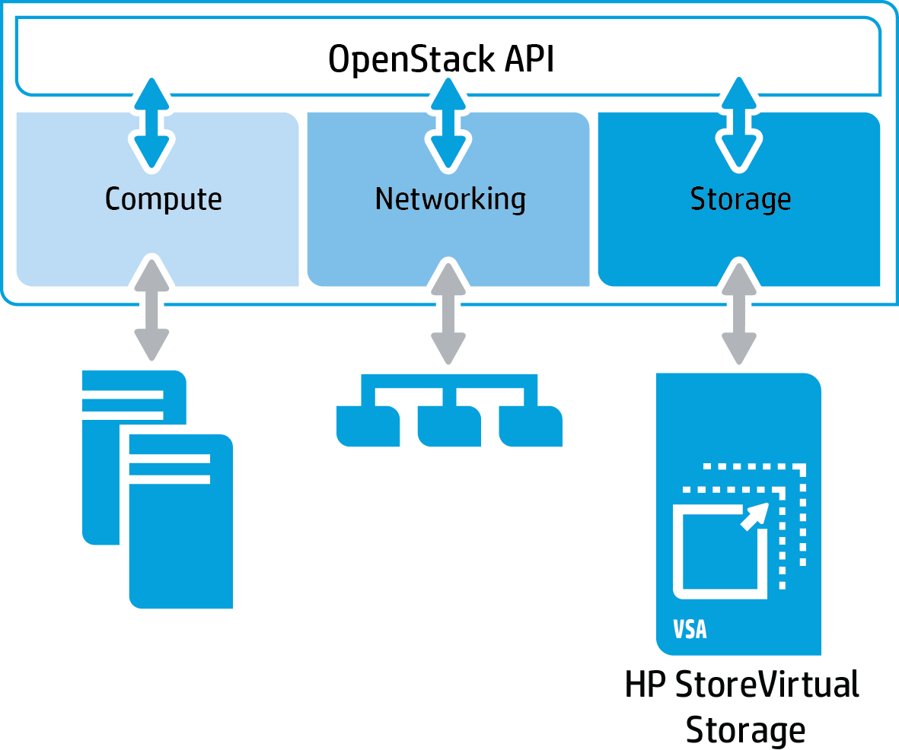
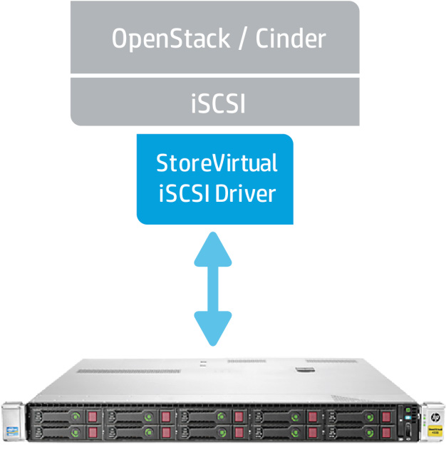
Block Storage – Cinder
HPE StoreVirtual VSA
HPE Helion OpenStack Block storage drivers
HP StoreVirtual

Slide 50



Block Storage – Cinder
HPE StoreVirtual VSA - Highly Available Infrastructure
Cinder/Store Virtual VSA features
Ethernet Fabric
Highly Available Storage
Network RAID mirrors data
One node fails other node takes over
No downtime & application disruption
Clustered Storage system
Network Mirroring

Slide 51
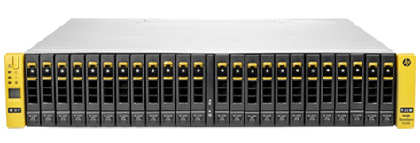
Block Storage – Cinder
HPE 3PAR StoreServ
HPE Helion OpenStack Block storage drivers
HPE 3PAR StoreServ

Slide 52

Block Storage – Cinder
3rd Party Cinder Driver Support
Built-in installation support for 3rd party storage
All 3rd party Liberty Cinder block storage drivers supported as long as the respective product has not been End Of Life
Over 50 drivers!
Matrix of drivers and OpenStack code supported features
https://wiki.openstack.org/wiki/CinderSupportMatrix

Slide 53
Object Storage with Swift & Ceph

Slide 54

Swift: High Level Architecture
Write
Clients
Read
RESTful API
Access Tier (Concurrency)
Auth
Service
All object in Swift have a URL
RESTful API over HTTP to operate on objects
Objects have metadata
Objects replication3x in unique zones which could be a node, drive, rack
Obj A
Obj A
Proxy
Proxy
Hash
Hash
Storage Tier
Cluster scales by adding nodes
No data migration required
Failed nodes remove, new nodes added without down time
Obj A
Obj A
Obj A
Storage
Storage
Storage
Storage
Storage
Zone 1
Zone 2
Zone 3
Zone 4
Zone 5

Slide 55
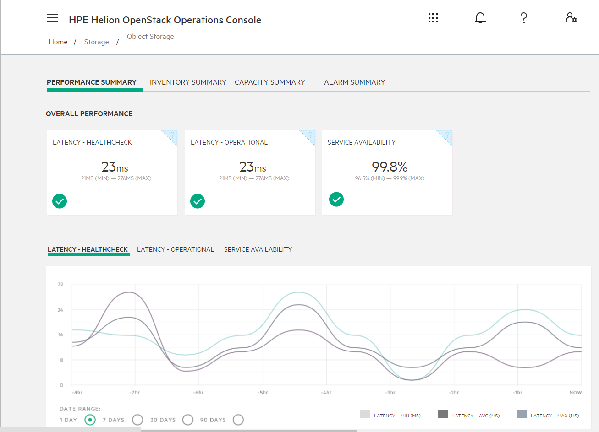
Swift: Performance Summary
Latency-operational:
Time it takes for Swift to respond to an upload, download or object delete request.
Service Availability:
Shows the service availability over the last 24 hours as percentage uptime.
Latency-healthcheck: Average time it takes to for Swift to respond to health check request (ping)g
Cumulative data:
Cumulative graph plotting for latency-healthcheck, latency-operation and service avilablity

Slide 56
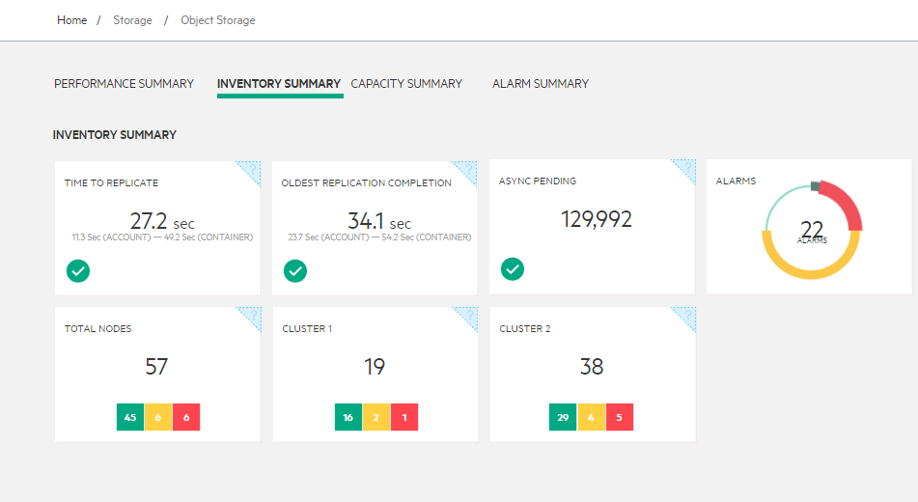
Swift: Inventory Summary
Oldest-replication completion:
Time since the object replication process completed its last replication cycle
Async Pending:
Length of the async pending queue of all object servers
Time to replicate:
Average time of all hosts for the object replication process to complete a replication cycle
Alarms:
Total number of alarms on nodes that hosts Swift services (proxy, account, container and object storage services)
Total Node:
Total number of nodes that run Swift services.
Cluster:
Total number of nodes that run Swift services in a cluster

Slide 57
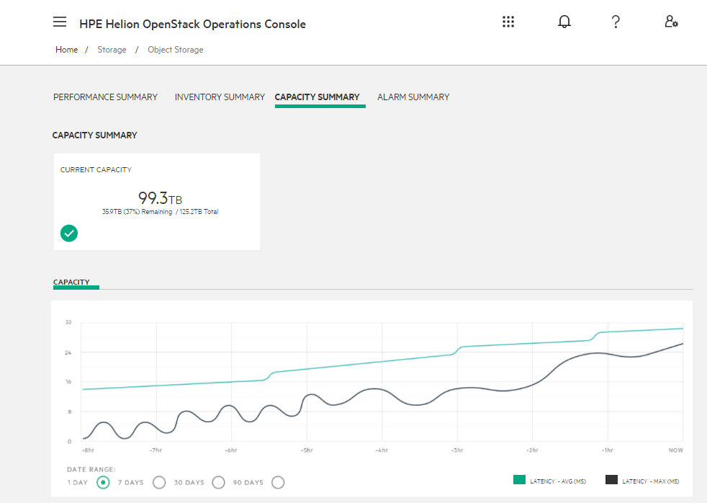
Swift: Capacity Summary
Capacity Summary:
Current capacity in use and bottom numbers are capacity left (unused) and total capacity

Slide 58
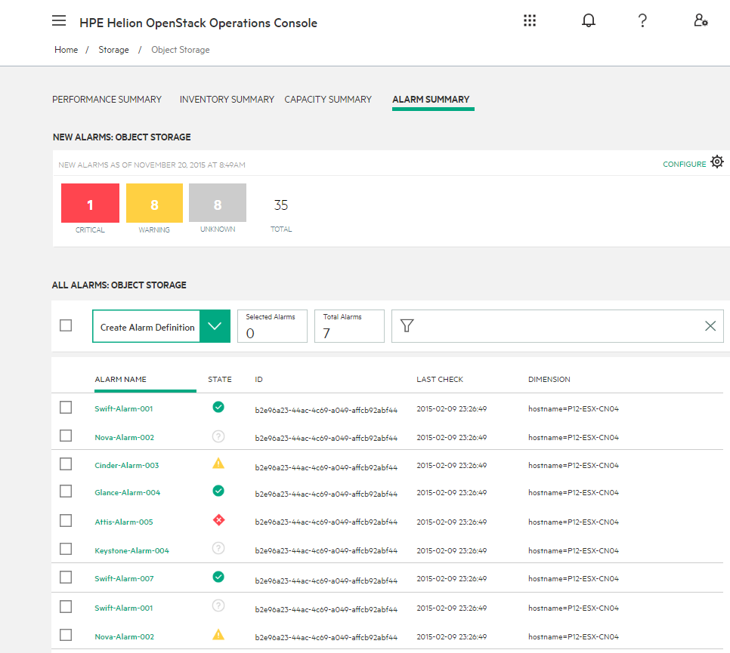
Swift: Alarm Summary

Slide 59

Ceph: Integration With HP Helion OpenStack
Unified Distributed Storage System
Ceph Firefly release
Helion OpenStack integration:
Cinder, Swift
Keystone, Glance, Horizon
Native HLM based installation and deployment
Monitoring
Logging
RADOS Gateway Support
Reliable Autonomic Distributed Object Storage
Offer object storage solution with Ceph cluster
Swift and S3 compatible APIs
Use any s3 client
Supports buckets and accounting
Per-object access control
Block
Object
File
RADOS
XFS
XFS
XFS
Media
Content store
Backup
Archive
Data
Analytics
Private
Cloud
Remote Office File Distribution &Sharing

Slide 60
Networking

Slide 61
OpenStack Neutron Architecture
Networking subsystem includes the API, control plane and data plane
Neutron API v2
Port, Network, Subnetcv
Neutron v2.0/Extensions
Security Groups, Provider Network, L3 Agent Scheduler, L3 Router, AAP, L4-L7 services
DHCP Agent
Data Plane
Control Plane
Neutron Server
Rabbit MQ
L3 Agent
Core Plugin
Service Plugin
L2 Agent
Control Plane PlugIn Service | Underlying Mechanism
LBaaS | HA Proxy, Octavia
FWaaS v1 | IPTables
VPNaaS | StrongSwan
L3 Router | Namespace
ML2
Monolithic
L3 Services
LBaaS
FWaaS
VPNaaS

Slide 62
Network Traffic Types
SNAT
Control Node
SNAT traffic still routed via Controller Nodes
FIP traffic uses external bridge
East West Traffic uses the tunnel bridge
VTEP – HV IP Tables is unicast using L2Pop Driver
All bridges are created using OVS
External Bridge
Tunnel Bridge
Compute Node
Compute Node
VM
VxLAN
Tunnel Mesh
VM
VM
Tunnel Bridge
Tunnel Bridge
VM
Integration Bridge
Integration Bridge
DVR
VM
VM
External Bridge
External Bridge
FIP
External Network

Slide 63
Liberty and HOS 3.0
Function Introduced in Liberty | Is in HOS 3.0 | Planned for HOS 4.0
Neutron QoS | No | Yes
SR-IOV/PFs ports | No | Yes
SR-IOV/VEB | No | Yes
Pluggable IPAM Framework | Yes w/ InflBlox | Yes with QIP, BlueCat
Neutron RBAC - Allow “specific” VM attach to a network - Deny the ability for some tenants to create new networks | Yes Yes | Attach specific provider/external networks to “specific” tenants.
AZ based DHCP and L3 Agent | No | Yes
Notes:
There are value added features which are not inherited from Liberty
Mellanox VXLAN Offload Support
MTU setting on ESX
Jumbo Packet Support
CVR HA (From Kilo)
Flexible Topology Support (HLM Automation) for
Multiple External Networks (HLM automation)
Separate Network Node (HLM automation)
ESX OVSvApp Installation for VLAN and VXLAN (HLM Automation)

Slide 64
Liberty and HOS 3.0
Function Introduced in Liberty | Is in HOS 3.0 | Planned for HOS 4.0
Curvature GUI | Yes | Yes
IPv6 - Operator (Services) - Management Networks - Prefix Delegation | No No Yes | Yes Yes
Port Level Security Group Enablement | No | Yes
L2 Gateway | Yes | Yes
DVR Connectivity across VLAN and VXLAN | No | Yes
CVR HA | Yes | Yes
DVR, SNAT HA | No | Yes

Slide 65
OVS-DPDK and SR-IOV with HOS 4.0
VNF
VNF
HPE Helion
OpenStack Control Plane
DPDK
Virtio (MSI-X)
Guest OS
Guest OS
VF
VF
VF
Intel VT-d and
SR-IOV
User Space
DPDK Accelerated vSwitch w/ vhost-user
x86 Platforms
FlexNIC Cards
NIC10/40Gbps NIC
with SR-IOV
Storage
Networking Switches

Slide 66
SR-IOV in Helion OpenStack 4.0
Control Node
Compute Node
PCI whitelist
vif_type=direct
Libvirt Driver
Nova Compute
vif xml
vif xml
SR-IOV Port state
ML2 plugin
Neutron
SRIOV Agent
Guest1
Guest2
sriovnicswitch
ovs
vNIC
vNIC
Hypervisor
Physical
NIC driver
DHCP Agent
I/O MMU (Intel for e.g)
L3 Agent
SR-IOV PCI Device (NIC)
Virtual Function#1
(vlan=1075)
…
Virtual Function#1
(vlan=1076)
L2 Agent
Virtual Ethernet Bridge
Open vSwitch
Physical Function
NIC
NIC
NIC
Tenant data network (VLAN Tagged)

Slide 67
PCI Pass-through in Helion OpenStack 4.0
Control Node
Compute Node
PCI whitelist
vif_type=direct-physical
Libvirt Driver
Nova Compute
ML2 plugin
vif xml
Neutron
SRIOV Agent
sriovnicswitch
ovs
Guest2
eth0.1024
(VLAN)
#1 Inside guest VLAN setting
DHCP Agent
Hypervisor
L3 Agent
Physical
NIC driver
#2 ToR VLAN setting
L2 Agent
PCI Device (NIC)
Physical Function
Open vSwitch
NIC
NIC
NIC
ToR
(PCI/PT NIC device port, set VLAN=1024)
Tenant data network (VLAN Tagged)

Slide 68
Operator Tools Monitoring, Metering, and Logging

Slide 69
Helion OpenStack 3.0 Operator Tools
모니터링 & 확장성
통합 로그 관리
사용자 리포팅
운영/관리 콘솔
컨트롤 노드 및 호스트 리소스 모니터링
시스템 성능, 리소스 가용/사용량 모니터링
실시간 알람 통지 기능(email, webhook, and UI)
사용자 모니터링 플러그인에 대한 유연한 확장성 제공
서비스/어플리케이션 로그 통합 수집 및 관리
다양한 로그분석 대시보드 제공
로그 클린업 자동화
비구조적 로그 데이터 검색
사용자 정의 뷰
로그레벨 설정
보안 감사 준수
멀티 테넌트 리소스 사용량 리포팅
Chargeback/show back 통계 기능 지원
3rd Party 운영관리시스템 연동 지원 (HPE ITOM, Talligent)
엔터프라이즈 레벨의 확장 아키텍처 제공
3rd Party 자원관리 시스템 연동을 통해 리소스 용량 통합 관리 가능
클라우드 서비스 상태 및 성능 통합 모니터링
서비스 알람 뷰 제공(등급/서비스/상태 등)
다양한 성능 추이 분석 그래프 제공
실시간 알람 생성 및 속성 업데이트
알람 통지 기능 관리(email, pager duty, web hooks)
Notes:
The OpenStack components (nova, neutron, cinder, etc) create JSON logs in the /var/log/<OpenStack component>. The Centralized Logging Service extracts the component level logs and funnels them into a pipeline and centralized storage.
The process starts with the Beaver daemon on each host watches data being added to the log files specified in the /etc/beaver/conf file
When a new message is logged a message to the RabbitMQ logstash-queue is generated. Logstash receives any message sent to the logstash-queue. Configuration is in the /etc/logstash directory. Logstash runs filters against the messages received from RabbitMQ. A basic filter view is provided as the default but how to create filters is a well-documented process in the elastic community. Logstash outputs all messages that have been received based on any output configuration. The Default is to use the elasticsearch_http interface to store the message in Elasticsearch database. Messages are stored in the Elasticsearch data store in the logstash-<YYYY-MM-DD>. Data can be queried directly through the Elasticsearch REST interface. Elastic search should be configured to only allow queries from the local machine. Kibana Dashboards query the Elasticseach data store and build customizable queries to help analyze and comprehend the log data. Kibana contacts the Elasticsearch data store to query the data in the logstore indices.

Slide 70
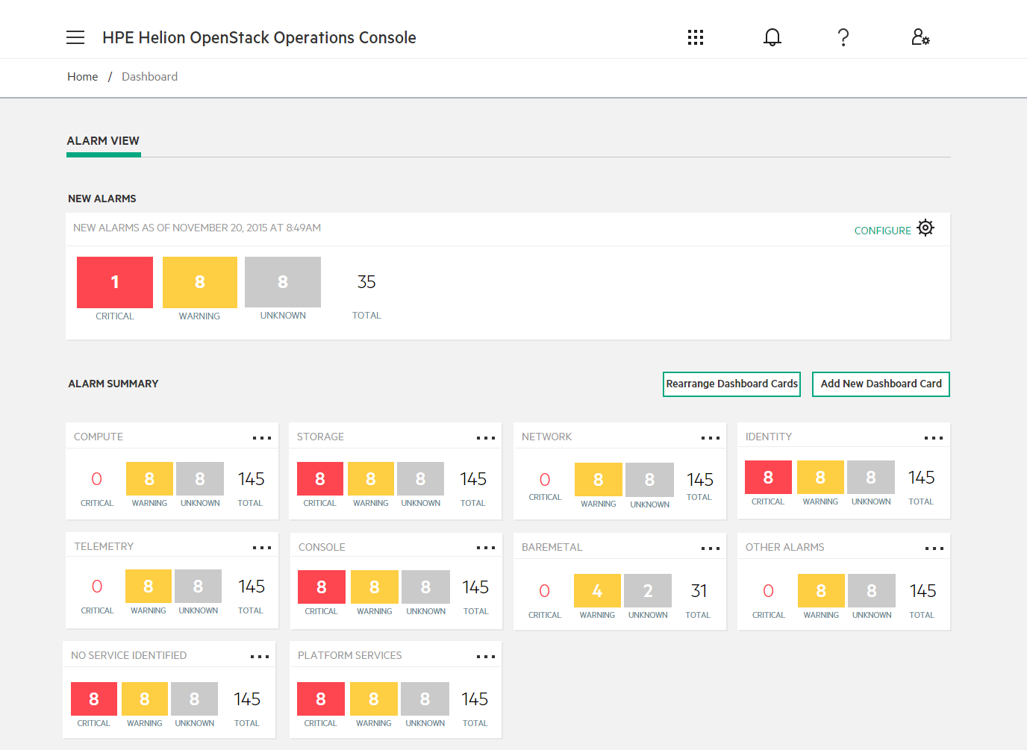
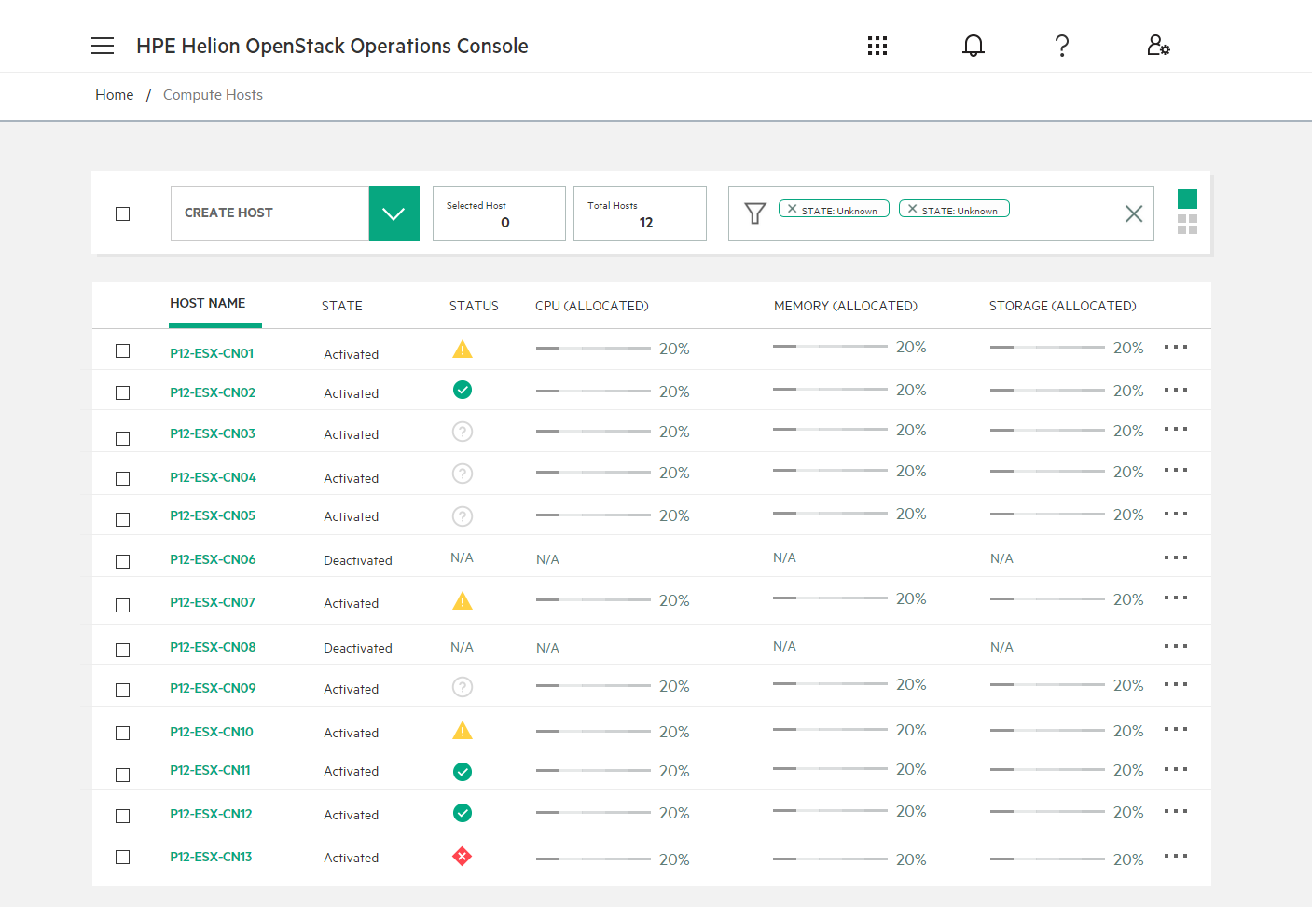
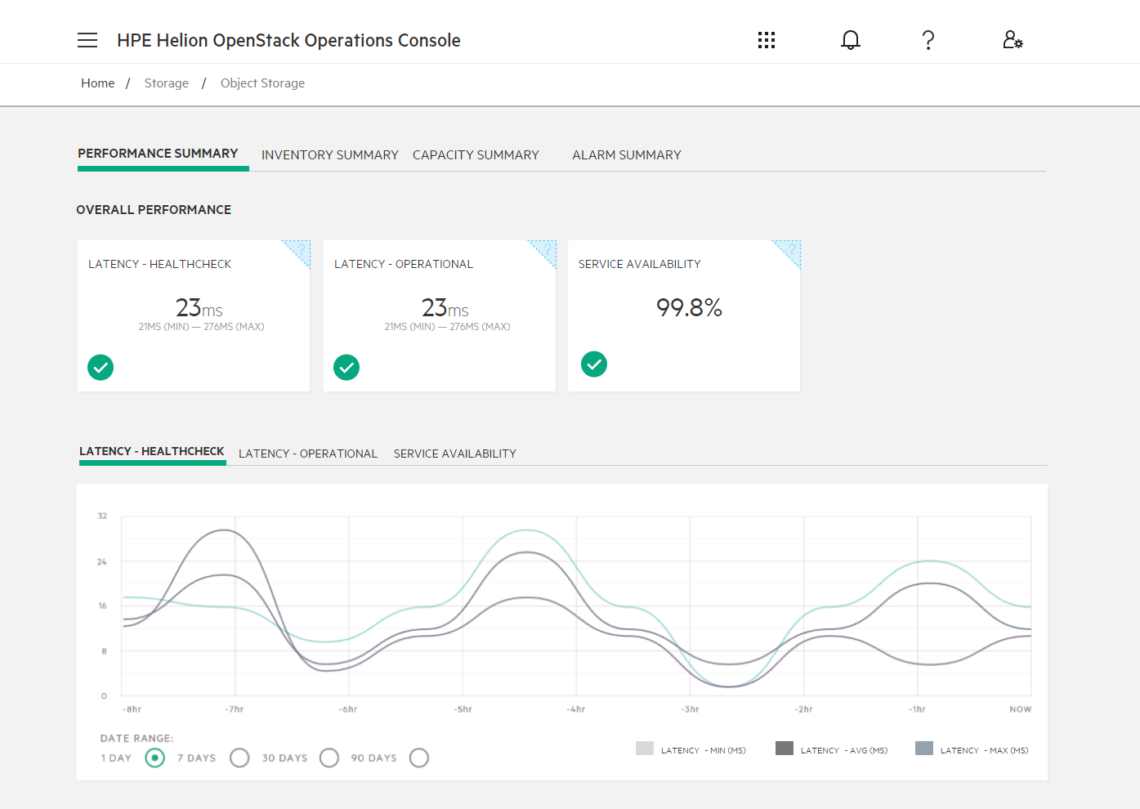
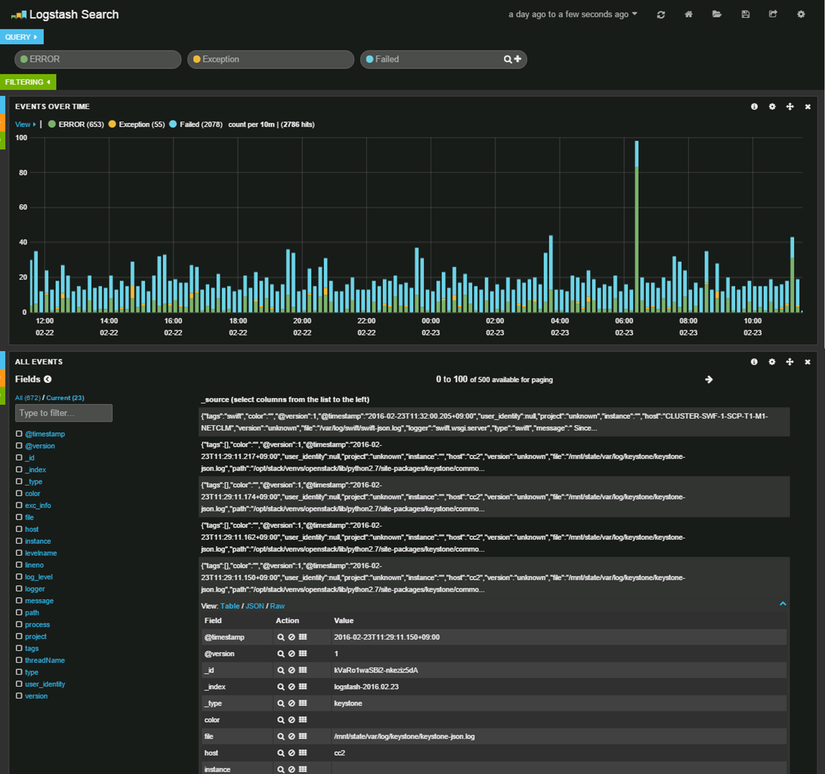
Helion OpenStack Dashboards
Centralized Operations Console for managing the health of your cloud
Monitoring and Operations
Ops Console
(operations dashboard)
Kibana
(logging search dashboard)
Monasca
(monitoring)
Logstash / ElasticSearch
(logging)

Slide 71
Monasca System Architecture
Supported
Future
Partial
Application
Cloud PaaS
Cloud IaaS
Control Plane
compute
network
storage
Notes:
Monasca is a highly performant, scalable, fault-tolerant and extensible micro-services messages bus based architecture. It uses a REST API for high-speed metrics processing and querying and has a streaming alarm engine and notification engine. All of the major components are linked using Kafka. Every component in the system is built with High Availability (HA) in mind and can be scaled either horizontally or vertically to allow for monitoring of very large systems.
The Monasca API is the gateway for all interaction with Monasca. In a typical scenario metrics are collected by the Monasca Agent running on a system and sent to the Monasca API. The API then published the metrics to the Kafka queue. From here the Monasca Persister consumes metrics and writes them to the Metrics database. The Monasca Threshold Engine also consumes the metrics and uses them to evaluate alarms.
At this point the metrics are in the system and can be be queried using the Monasca API, either directly or through one of the other components, such as the Horizon plugin or the Monasca CLI.
When the Threshold Engine evaluates the metrics against the alarms it can create alarm state transition events. These are published back to Kafka and are read by both the persister and Notification Engine. The Persister writes the alarm transitions to the DB for future retrieval. The notification engine will send a notification of the configured type for appropriate state transitions.
In addition to the components discussed above there is also a configuration database used for storing information such as alarm definitions and notification methods. This database can be either MySQL or PostgreSQL.
For more information: http://monasca.io/root/architecture/

Slide 72
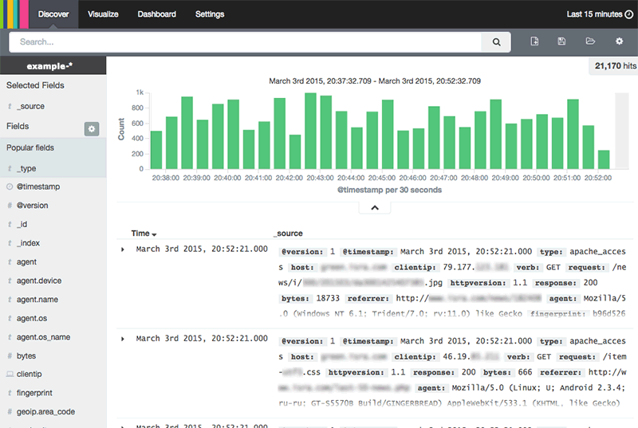







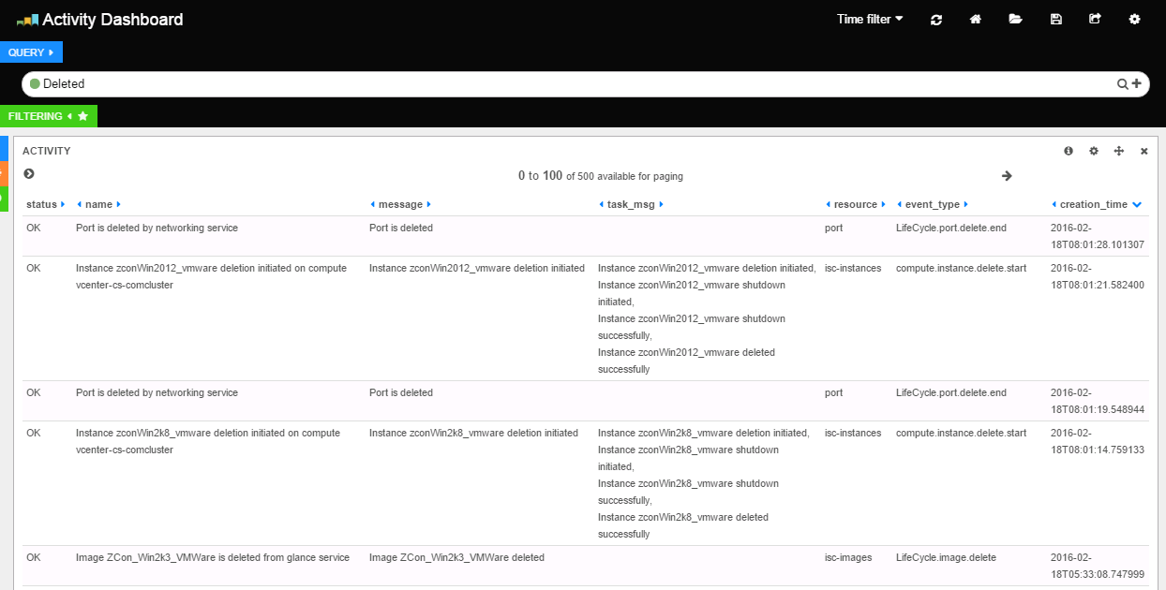
Centralized Logging
Silos vs. Centrally available
Horizon
Keystone
Cloud
Operator
Project User
1
2
Beaver
Shipper
Kafka
Transport
Logstash
Transform
ElasticSearch
Search
Kibana
Visualize
Compute
Image
Storage
Network
3
4
5
6
?
Where are the logs?
Cloud
Operator
Notes:
The normal request flow, for example, made by an enterprise user to create a VM from Horizon:
Horizon => Get token from Keystone => Horizon API call to nova => nova calls keystone to validate token => nova makes calls to glance, cinder, neutron services => nova scheduler => nova compute creates vm=> attach storage=>Error
Nova and Cinder logs will show debug level information for the VM creation failure. To be more precise you can narrow the log view in Kibana to reflect the time that the monitoring alarm was triggered.
Centralized Logging enables:
Decreases problem resolution time
Simplifies troubleshooting
Reduces operational costs
Gains efficiencies over time (saved search)
Other use cases:
Looking for failed login at the Horizon portal Search
Message: “Login failed for”
Table shows the failed login name
Other interesting message search:
@message"error"
The following will show you errors on a specific host:
“hostname” AND ERROR
The following will show you nova errors on all nodes:
* AND nova AND ERROR
http://www.elasticsearch.org/guide/en/kibana/current/using-kibana-for-the-first-time.html
http://www.elasticsearch.org/guide/en/kibana/current/working-with-queries-and-filters.html
Looking for entries with ERROR and WARNING log level Search

Slide 73
Helion OpenStack vs Red Hat OSP

Slide 74
Helion OpenStack vs Redhat OpenStack 비교 요약
 | Helion OpenStack | Red Hat Linux OpenStack Platform
OpenStack Core Service | Horizon, Heat, Cinder, Nova, Glance, Swift, Ceilometer 지원 | Horizon, Heat, Cinder, Nova, Glance, Swift, Ceilometer 지원
Deployment Method | Ansible + Cobbler + Git Repository 범용적 오픈소스 기술을 사용해서 배도를 단순화 | TripleO ( Director -> Under Cloud -> Over Cloud 순으로 설치) OpenStack On OpenStack으로 오픈스택 자체 기능으로 배포 관리
OpenStack Controller Cluster | HAProxy, KeepAlived, Galera, RabbitMQ Cluster 오직 오픈소스 기술만을 사용해서 Cluster 고가용성 구현 | HAProxy, Pacemaker, Galera, Memcached Red Hat이 보유하고 있는 자체 기술과 오픈소스 사용해서 구현
Cluster Architecture | Deployer (Optional) + OpenStack Cluster | Director + Under Cloud + Over Cloud (Opentack Controller)
Monitoring Service | Monasca (오픈스택 모니터링 서비스 프로젝트) 오픈스택 설치 시에 일괄 설치 및 통합 Lifecycle 관리 | Grafana+Graphite+collectd 오픈 스택 설치 이후 별도로 설치해야 하며 독립적으로 관리
Central Logging Service | ELK (ElasticSearch + LogStash + Kibana) 오픈스택 설치 시에 일괄 설치 및 통합 Lifecycle 관리 | EFK (ElasticSearch + Fluentd + Kibana) 오픈 스택 설치 이후 별도로 설치해야 하며 독립적으로 관리
Backup Service | Freezer (오픈스택 백업 서비스 프로젝트) 오픈스택 설치 시에 일괄 설치 및 통합 Lifecycle 관리 | 별도의 제품 필요
Host OS | 기본적으로 Debian 계열 hlinux 사용, RHEL 사용 가능 | RHEL 사용 가능
오픈스택 Core 기능 Hardening과 엔터프라이즈에서 안정적으로 운영하기 위한 필수 서비스와의 연동과 편리한 LifeCycle 기능 제공
Red Hat의 강정인 안정적인 RHEL과 자체 보유 소프트웨어를 사용해서 새로운 Value를 오픈스택에 추가

Slide 75
서비스 및 기술 지원

Slide 76

Support for HPE Helion OpenStack
Foundation Care
Interact with experts in HPE’s Global Cloud Center of Expertise as single source of support and accountability
Global access to HPE’s OpenStack® software technical support experts included in every subscription
Help with software features and operational support
Installation advisory support
Ownership and accountability through to resolution
Notes:
Foundation Care is available in the form of either 24x7 or 9x5 support. Support is included in the HPE Helion OpenStack subscription: $1200 per 1 year subscription for 9x5 support and , $2200/ 1 year subscription for 24x7 support.

Slide 77
HPE Helion OpenStack Professional Services
Converting OpenStack Deployments into Opportunity
DEVELOPMENT OPERATIONS
PRIVATE CLOUD
RETAIL AND WEB SCALE
OPENSTACK STORAGE
OPENSTACK WORKLOADS
ADVISE
TRANSFORM
MANAGE
Assess client OpenStack deployment
Define success steps
Education consulting and custom courses
Accelerate design and implementation based on best practices
Custom OpenStack development
Migrate to HPE Helion OpenStack
Proactive OpenStack architecture management
Software maintenance consulting
Capabilities and scale introduction
Notes:
In addition to the basic HPE Helion support services, HPE provides layers of services for cloud deployment and management through HPE Helion Professional Services. Customers will benefit from the support of HPE Helion OpenStack Professional Services (PS), which can assist customers through:
Advise: PS can conduct reviews of OpenStack capabilities and environments to deliver recommended next steps in design or remediation, facilitate OpenStack familiarity, and evaluate a team’s readiness for using OpenStack IaaS in specific large business environments.
Transform: PS will use best practice design and implementation procedures to integrate OpenStack into a pre-production environment or design/review an architecture and assist with OpenStack deployments. It will assist in helping move applications to Helion OpenStack, and leverage OpenStack Heat, Ceilometer Keystone, and other projects to maximize the effectiveness and usability of an OpenStack implementation.
Manage: PS can assist customers in ensuring that OpenStack implementations are optimized for scalability and security and can effectively onboard new cloud applications as needed.

Slide 78



HPE Helion OpenStack - Support flow
Customer
HPE Support Center
CloudSystem/Helion Center of Expertise (CoE)
CoE Characteristics
HPE Helion OpenStack customer
Technical Support Specialists
24x7 operation, global team
OpenStack and Helion trained Technical experts
Balance of broad and deep skills on Cloud Solutions
Full case ownership
R&D and ISV collaboration
Quality mindset
Follow-the-sun for continuous effort
Call Receipt
COLLABORATION AND ELEVATION
Phone, Web
HPE Support Center
Field/support Engineers
Helion Professional Services (HOPS)
Helion R&D Support
3rd Party Partners
HPE Helion OpenStack advise, enterprise integration, and optimization consulting
Helion engineering team

Slide 79
감사합니다.

